Slide 1
Facilitating Improvement in Teacher Practice
Learning Module 3
Leading Improvement Work

Slide 2
Acknowledgments
This module series includes work that has been adapted from successful strategies developed by Alicia Bowman and Kim Austin for the Regional Educational Laboratory West (REL West) at WestEd.
We would like to acknowledge the Center for the Collaborative Classroom and Washoe County School District for their partnership in this work. We would also like to acknowledge the Carnegie Foundation for the Advancement of Teaching for its contributions to the field that are cited in this work.
Citation: Bowman, A., & Austin, K. (2021). Facilitating Improvement Professional Learning Modules—Module 3: Leading improvement work [Slide deck]. Washington, DC: U.S. Department of Education, Institute of Education Sciences, National Center for Education Evaluation and Regional Assistance, Regional Educational Laboratory West.
This product was funded under Contract ED-IES-17-C-0012 by Regional Educational Laboratory West administered by WestEd. The content of this product does not necessarily reflect the views or policies of the Institute of Education Sciences or the U.S. Department of Education, nor does mention of trade names, commercial products, or organizations imply endorsement by the U.S. government.

Slide 3
Welcome
Notes:
We recommend that you include a slide to introduce the facilitation team. This is also where you can build in an opportunity for participant introductions.

Slide 4
Community agreements
(Developed by the cohort in Module 1)
Notes:
Review the community agreements that you developed together during Module 1.
Ask participants to identify an agreement for themselves that they would like to focus on for the day. They do not need to share what they selected.

Slide 5
Progress check-in
Introductions (name/role, if needed).
(2 minutes) Round-robin check-in:
In one word, how are you feeling today?
(8 minutes) Progress checks:
Since our last session, what have you been working on?
Has anything changed that impacts your work?
Closing.
Notes:
In small groups, ask each table to have a progress check-in or use breakout rooms in a virtual setting. Emphasize that you’ll use this check-in process each session. It is designed to introduce a procedure that will become routine over time, much like the meetings or huddles in the improvement process.

Slide 6
Learning arc for modules
Notes:
Explain to participants that this session is to help prepare them as leaders and facilitators to carefully lay the foundation and scaffold the interaction during continuous improvement activities to ensure a successful process.

Slide 7
Improvement questions
We have four key improvement questions to improve our work:
1. What are our priority needs?
2. What is the problem we are trying to solve?
3. What might we change or introduce and why?
4. How will we test and build confidence in our changes?
Source: Adapted from Langley (2009).

Slide 8
Learning targets
Understand the role of the facilitator in leading improvement work.
Learn about some key strategies for building and developing teams.
Learn about some key routines and structures for continuous improvement.
Notes:
As you describe the learning targets, mention some of the key points.
Key points:
• It is worth the time and effort to lay groundwork for productive discussions by building strong teams and promoting positive group dynamics.
• Establishing expectations for collaboration and following simple but set routines will allow teachers to focus on content in a safe environment.

Slide 9
Topics
Leading improvement work.
Team development.
Promoting positive group dynamics.
Meeting planning and facilitation.
Meeting routines in action: Learning huddles.

Slide 10
Leading improvement work

Slide 11
Leading improvement work
Leading improvement work means that, in your role, you support educators to work together to improve their practice.
Supporting them to use continuous improvement processes provides structure to help educators have a disciplined approach to learning and sharing what they have learned for the benefit of all.
Notes:
Explain to participants that in this section, we will specifically think about the role of a facilitator and some of the tasks and dispositions to consider as you prepare to lead a team through a continuous improvement process.

Slide 12
Self-reflection
What are my strengths in working with groups of educators?
What is my biggest concern about facilitating a group?
What areas do I need to improve or be mindful of?
Pair share:
Share your reflections on one of these questions with a partner.
Notes:
Provide 2–3 minutes for individual reflection in the workbook and then 3–4 minutes for a pair share.

Slide 13
Leading an improvement team
Key attributes of an improvement team:
Focusing on improving your system.
Engaging in continuous improvement and inquiry.
Learning together.
Measuring results.
Celebrating success.
Sharing your learning.
Notes:
Explain that each of these features of a successful improvement team requires a safe, collaborative environment. Highlight a couple of key attributes and share (or ask participants to share) why it might be hard to do this without a facilitator managing conditions for success.

Slide 14
What will you do as an improvement facilitator?
As a facilitator, you are creating the conditions and holding space for teams to complete inquiry cycles. A facilitator …
Plans and facilitates meetings.
Manages group dynamics.
Provides structure and guidance for inquiry cycles.
Plans and structures learning huddle protocols for teams.
Supports data collection and documentation of learning.
Optional: builds a community of team leads.

Slide 15
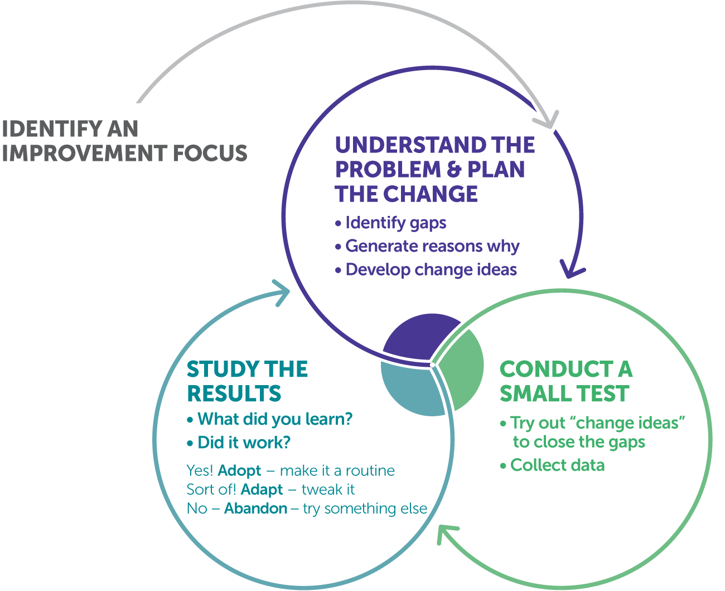
Teacher inquiry cycle
Teacher inquiry is defined as a systematic, intentional study of one’s own professional practice.
The most effective way to learn is collaboratively.
Supporting effective teacher inquiry involves both facilitating routines and facilitating team collaboration.
Source: Dana (2014).
Notes:
Explain that, as was mentioned in Module 1, a teacher inquiry cycle is a vehicle for continuous improvement with teams of teachers. To effectively facilitate continuous improvement, both meeting routines and the dynamics of team collaboration need to be attended to.

Slide 16
Poll
How have you engaged in teacher inquiry in the past?
As a teacher.
As a team leader.
As a facilitator or coach (external to the team).
As a school administrator.
Discussion:
What did you learn from that experience?
Notes:
The workbook has a section for self-reflection, or this can be a poll with raised hands or, if facilitating online, using the poll function.
Awareness of the mental models we hold personally or as shaped by our roles can form the dynamics of a team. As a facilitator, you want to draw on positive experiences while being conscious of negative learning experiences, so that they are not duplicated.

Slide 17
Facilitating a team
As we discussed in Module 2, our mental models can shape how we react to and attempt to solve problems.
As a facilitator, you need to be aware of your natural preferences and how they can impact your decisions and behaviors while working with teams.

Slide 18
Facilitating a team
Technical preferences
Task completion
Rules and plans
Isolated activities
Individualism
Relationships and interconnectedness
Ambiguity and discovery
Systems
Interdependence
Relational preferences
What are your preferences as a team member?
How might your natural preferences impact your facilitation when under stress?
Source: Lipton & Wellman (2012).
Notes:
This slide can be a pause point for self-reflection in the workbook, followed by pair share or small-group discussion, depending on the needs of your participants.
Explain that these differences occur in all teams. The goal is to know how to organize and facilitate productive discussions despite differences.

Slide 19
Facilitating a team
Remember:
Understand your preferences and the preferences of your team members.
Structure activities to vary to meet different needs.
Acknowledge when activities may be outside the comfort zone of some team members.
Check in with your team regularly to make sure members’ needs are being met.

Slide 20
Team development
Notes:
Remind participants that conflict in teams is natural. Explain that in these next two segments, we’ll look at how they can move teams through the stages of development and promote healthy discourse despite different mental models and styles of interacting.

Slide 21
Team development
A group of people, even if they have a common purpose, is not necessarily a team.
All teams have ups and downs, and as a facilitator, part of your role is to help the team to continue to develop.

Slide 22
“In great teams, conflict becomes productive. The free flow of conflicting ideas is critical for creative thinking, for discovering new solutions no one individual would have come to on his own.”
—Peter Senge

Slide 23
Conflict in teams is natural
Healthy conflict | Unhealthy conflict
Focus on task issues. Legitimate differences of opinion about the task. Differences in values and perspectives. Different expectations about the impact of decisions. | Competition over power, rewards, resources. Conflict between individual and group goals. Disorganized team meetings. Community agreements not established or not honored. Personal grudges from the past. Faulty communication.
Source: Dechurch, Mesmer-Magnus, & Doty (2013).

Slide 24
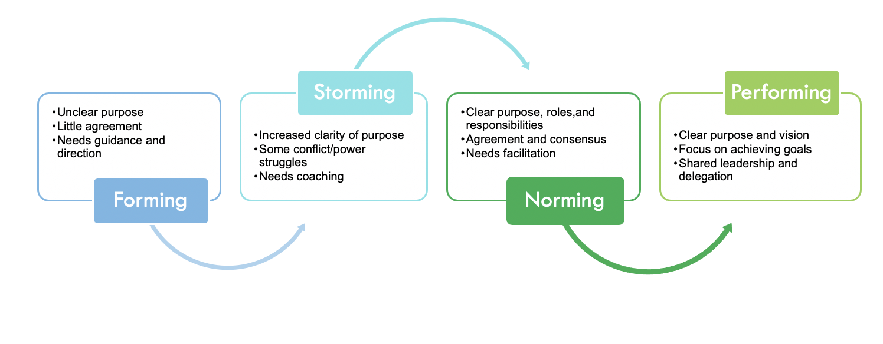
The stages of team development
Source: Tuckman (1965).
Notes:
Explain that teams go through different stages of development over time and in response to changes. Teams can move quickly through some of the early stages with skillful facilitation and planning. When conditions change, teams can also move back to storming and require re-norming. Time permitting, encourage participants to share examples of teams they have been on or have facilitated in the different stages of development. Have your own examples ready to share here and on slides 25–28.

Slide 25
Facilitator actions for managing team dynamics
Forming
Clarify group’s purpose, roles, and responsibilities. Establish community agreements. Provide information and direction—build understanding. Surface and be sensitive to member needs. Encourage risk-taking. Foster communication. Introduce routines and processes.

Slide 26
Facilitator actions for managing team dynamics
Storming
Encourage multiple voices and perspectives. Revisit purpose, roles, and responsibilities. Review/revise community agreements. Acknowledge conflict when it occurs. Seek and provide information and clarity. Redirect conversations to community agreements/goals.

Slide 27
Facilitator actions for managing team dynamics
Norming
Request and encourage feedback on your facilitation. Monitor participation to delegate and share responsibility. Continue to revisit and update community agreements. Recognize accomplishments. Monitor team effectiveness and morale. Encourage collaboration inside and outside of the team meetings. Identify learning opportunities.

Slide 28
Facilitator actions for managing team dynamics
Performing
Celebrate and publicize accomplishments. Identify team development opportunities. Create space for mutual support and encouragement. Establish flexible roles and shared leadership. Evaluate team effectiveness and morale.

Slide 29
The stages of team development
Which of these stages do you feel your team is currently experiencing?
Are your internal conflicts healthy or unhealthy?
Source: Tuckman (1965).
Notes:
This slide can be a pause point for self-reflection in the workbook, followed by pair share or small-group discussion, depending on the needs of your participants.

Slide 30
Promoting positive group dynamics

Slide 31
Changing the narrative
“Narratives are shaped by mental models, but narratives also, over time, shape the mental models we have.”
Kania, Kramer, & Senge (2018)
Notes:
Explain that the goal in collaborative inquiry is to have productive discourse, no matter what mental models team members hold and what stage of development the team is in. We’ll look at different forms of productive and unproductive discourse that affect team dynamics.
Suggest participants highlight key phrases or take notes in their participant workbook.

Slide 32
From complaint to commitment
Language of complaint (unproductive) | Language of commitment (productive)
Expresses what we cannot do. | Expresses what we aspire to or stand for.
Sounds negative or cynical. | Communicates conviction or possibility.
Frustrates individuals or shuts down the conversation. | Inspires and brings energy to the conversation.
Nontransformational: lets off steam but does not help move toward solutions. | Transformational: builds a foundation for purpose-driven work.
Source: Adapted from Kegan & Lahey (2001).

Slide 33
From blame to personal responsibility
Language of blame (unproductive) | Language of personal responsibility (productive)
Holds other people responsible for gaps between intentions and reality. | Generates productive conversations that lead to problem-solving.
Built on generalizations and alienation of others. | Draws on our commitments and encourages collaboration.
Discourages exploration. | Raises questions to be answered.
Nontransformational: deflects attention to outside of the locus of control. | Transformational: directs attention to where we have the most influence.
Source: Adapted from Keegan & Lahey (2001).

Slide 34
From assumptions to an inquiry stance
Language of assumptions (unproductive) | An inquiry stance (productive)
Voices ingrained mental models. | Examines data and evidence.
Makes unsubstantiated judgments. | Asks questions.
Includes broad generalizations. | Looks at multiple perspectives.
Nontransformational: reframes problems based on past experiences instead of reality. | Transformational: gets to the root causes of problems using evidence.
Source: Adapted from Kegan & Lahey (2001).

Slide 35
Shifting group discourse
From complaint to commitment | The language of complaint surfaces frustration, while also demonstrating that people care about something. Shifting this discourse often involves surfacing what the speaker cares about.
From blame to personal responsibility | The language of blame surfaces an expression of helplessness. Shifting the discourse often involves helping the speaker locate where they have agency.
Language of assumptions to an inquiry stance | The language of assumptions voices the mental models built from our experiences or that is structurally built into our systems. Shifting the discourse often involves using data and evidence to drive discussions.
Source: Adapted from Kegan & Lahey (2001).

Slide 36
Discourse sort activity
In small groups, sort the provided quotes into the following categories:
Language of complaint.
Language of commitment.
Language of blame.
Language of personal responsibility.
Language of assumptions.
Inquiry stance.
Each group will be assigned a set of quotes. As you discuss each quote, share why you believe it is a particular language, and if it is unproductive language, what you might say to help shift the discourse.
Notes:
Participants will need to use the materials in Appendix 1 in their participant workbooks to engage in this activity. The quote sets are also on the next several slides.
This activity is designed for a group of four. If you have more groups than available quote sets, you may have multiple groups use the same quotes. If you have additional time, you can provide teams with multiple sets.

Slide 37
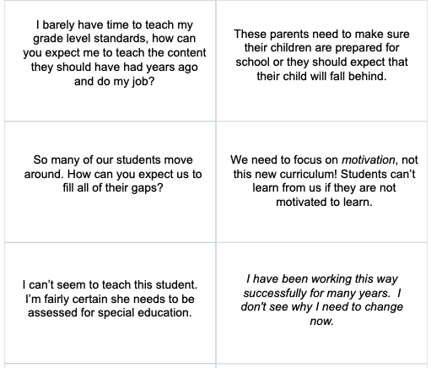
Discourse sort activity – Set 1

Slide 38
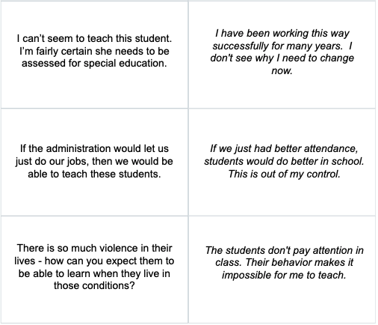
Discourse sort activity – Set 2

Slide 39
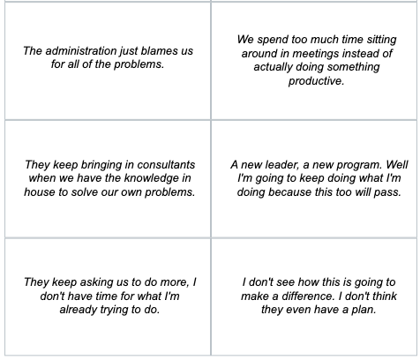
Discourse sort activity – Set 3

Slide 40
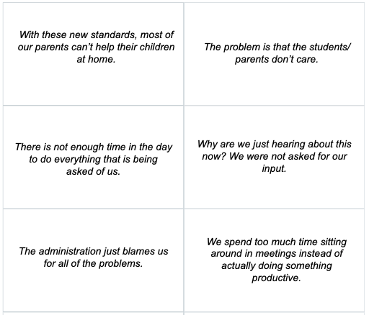
Discourse sort activity – Set 4

Slide 41
Discourse sort activity
Whole group share-out:
Please share a highlight from your group.
Notes:
Briefly have each group share a highlight from their discussions during the activity. How did they decide as a team what type of discourse each of the statements were? Were any of the statements familiar?

Slide 42
Equity pause
EQUITY
PAUSE
Take a moment to think about the discourse around inequities in your school or district.
What types of discourse do you hear most frequently?
Can you think of a time when unproductive discourse has been a barrier to addressing an equity issue?
Notes:
This equity pause can start with a self-reflection in the workbook, then share in a small-group or whole-group discussion, depending on the size of your group. It is important that the discussion groups are small enough for everyone to be able to participate.
You will likely hear some similar statements to those in the discourse sort activity. When possible, probe for when unproductive discourse slowed work down or stopped it all together.

Slide 43
Begin with listening ...
When listening to unproductive discourse, we often make judgments.
This “fast thinking” may cause us to react in ways that are counterproductive to our goals.
To shift unproductive discourse, you need to listen without judgment.
Notes:
Remind participants to be mindful of the mental models they may be carrying and how these models might affect their facilitation.
Avoid judgment and fast thinking by listening carefully and using productive discourse strategies.

Slide 44
Meeting planning and facilitation

Slide 45
Self-reflection
What types of meetings do you usually plan?
How do you know they are successful?
Notes:
Provide a few minutes for individual reflection in the workbook, and then ask if anyone would like to share their response with the group. Take two to three responses and move on. Emphasize how participants know a meeting is successful.

Slide 46
Types of meetings
General grade or department team meetings: plan initial inquiry, reflect on and share learning.
Learning huddles: maintain progress for ongoing inquiry, share early learning, make necessary adjustments and articulate next steps.
Check-in meetings: check in on progress of inquiry and troubleshoot issues.
Notes:
Tell participants that these three types of meetings are embedded in the inquiry cycle. Describe each and align them with the meetings participants mentioned in the self-reflection.

Slide 47
What is a successful meeting?
For a meeting to be successful, it is important that all teachers …
1. Come prepared.
2. Listen actively and attentively.
3. Maintain a positive group dynamic (verbal and nonverbal).
4. Are focused and on task.
5. Complete all meeting objectives.
6. Ensure equity of voice (everyone is given the opportunity to speak).
7. Are reflective about their practice.

Slide 48
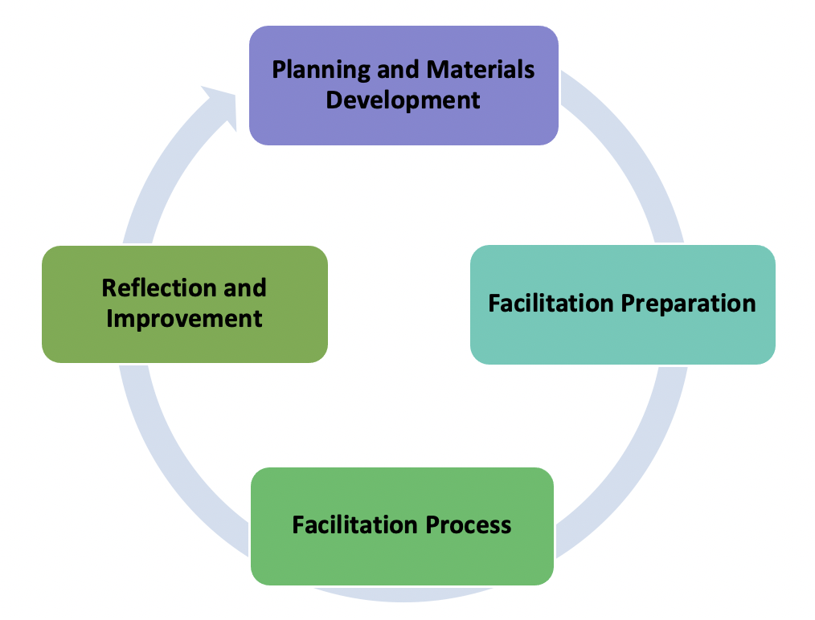
Meeting planning and facilitation process
Before the meeting:
Planning and materials development.
Facilitation preparation.
During the meeting:
Facilitation process.
After the meeting:
Reflection and improvement.
Notes:
Tell participants that they can scaffold for a successful meeting, attending to what needs to happen before, during, and after the meeting.
As you talk through the checklists, suggest participants highlight in their workbook the things they already do and circle ones they want to add to their meeting facilitation skills.

Slide 49
Planning and materials development

Slide 50
Planning and materials development
As the facilitator, it is important to make sure that you set aside time to plan your meeting and develop or collect any necessary materials ahead of time.

Slide 51
Planning and materials development
Planning your meeting goes beyond creating an agenda. Often, activities need to be selected, necessary data need to be identified, and facilitation roles need to be determined.
The following slide is a checklist to help you to think about some of the actions that might be part of your planning process.

Slide 52
Meeting planning checklist
Create a facilitator's agenda.
Establish community agreements/roles.
Develop meeting goals or outcomes.
Create activity directions based on the type of meeting (general, learning huddle, or check-in).
Determine who will facilitate each portion of the agenda.
Identify possible contributions from staff or bright spots that might be included in the meeting.
Determine whether any content support will be necessary for the meeting and ask the relevant individuals to help plan and attend.
Schedule a facilitation debrief meeting and prepare for any work between meetings.
Notes:
(handout)

Slide 53
Planning and materials development
Materials development includes making sure that you have everything you need to complete your planned activities. This includes creating any unique tools or note-taking documents (including huddle protocols), collecting and preparing data for review, and making sure copies of necessary documents are available.
The following slide is a checklist to help you to think about some of the actions that might be part of your planning process.

Slide 54
Materials development checklist
Review the facilitator's agenda to develop content slides and activities.
Create participant agendas and handouts (may include a huddle protocol, note-taking documents, and so on).
Designate people responsible for preparation tasks.
Determine when materials need to be ready.
Review materials before the meeting to ensure everything is ready.

Slide 55
2. Facilitation preparation

Slide 56
Organization systems checklist
Create accountability process (products to collect, timelines, expectations).
Identify how you will collect the team’s work products and where they will be stored (online folders, binders, and so on).
Develop team meeting feedback survey/tool.

Slide 57
Communication checklist
Identify the learning/support needs of each team member and where differentiated support might be needed.
Check with facilitators and clarify roles and responsibilities for the meeting.
Check in with team leads/members to make sure they know what to bring to meetings.
Invite content specialists who may be able to support the work.

Slide 58
Preparation checklist
Review learning huddle protocol and materials.
Add facilitation notes to a facilitator version of the protocol.
Anticipate any possible team dynamic issues and how you might respond.
Review the agenda and materials to make sure everything is prepared and you have enough copies.

Slide 59
Small-group discussion
Look at the meeting planning, materials development, and facilitation preparation checklists in your handout.
Share with your group:
Which of these steps are part of your usual process? Are there any steps that you want to add to your routine?
Notes:
Provide time to share in small groups for 10 minutes.
When you return to the whole group, ask which steps were part of the usual process. Note commonalities. Ask which steps participants want to add to the routine. If there are similarities, ask why they don’t use them now and what it would take to make them part of their routine.

Slide 60
3. Facilitation process
Notes:
As you talk through the facilitation moves, suggest participants highlight in their workbook the moves they consider strengths and circle ones they think are areas for growth.

Slide 61
Managing multiple preferences
Build relationships:
Allow time for individuals to transition into the meeting.
Review community agreements.
Provide guidance and structure:
Create clear meeting objectives and tasks.
Be goal-oriented:
Make connections between the work of a particular meeting and the overall goals of the team.
Foster interdependence:
Share successes and collective impacts.

Slide 62
Meeting facilitation
Open with an icebreaker or warm-up.
Icebreakers and warm-ups may sometimes seem extraneous, but in fact they play an important role. They help meeting participants to have a clean break from the activities they were engaged in before the meeting. This allows them to be more focused during the meeting.
Depending on the activity, icebreakers and warm-ups can also be community builders and serve as an entry point to the participants’ common work.

Slide 63
Meeting facilitation
Review community agreements.
Community agreements are effective only if they are used consistently. They are an important facilitation tool when things start going off track. Even if it feels repetitive, it is important to always remind the team members of their agreements.
Initially you may want to review the agreements and identify those that might be helpful for navigating the particular work of a meeting, but eventually you can ask participants to read over the agreements on their own and identify one that they would like to focus on for themselves.

Slide 64
Meeting facilitation
Collect notes and artifacts.
When engaging in improvement work, it is important to document your learning as you go. This documentation helps you to see the shifts in thinking and to capture successes and failures, and eventually allows you to share your journey with others.

Slide 65
Meeting facilitation
Establish and agree on clear next steps.
One of the biggest pitfalls in improvement work is a lack of follow-through. It is important that everyone on the team agrees on the next steps, deliverables, and timelines.
Making agreements as a team creates a team culture of shared accountability.

Slide 66
Meeting facilitation
Collect feedback.
There is always room for improvement in meeting design and facilitation. Consistently asking for and acting on feedback from the team promotes agency and contributes to the collective efficacy of the team.

Slide 67
Meeting facilitation processes
Open with an icebreaker or warm-up.
Review community agreements.
Collect notes and artifacts.
Establish and agree on clear next steps.
Collect feedback.
Which of these facilitation moves do you consider to be strengths? Which are areas of growth?
Notes:
This slide can be a pause point for self-reflection in the workbook. You may also choose to include a pair share or small-group discussion, depending on the needs of your participants and time available for the additional discussion.

Slide 68
4. Reflection and improvement
Notes:
As you discuss the reflection and improvement checklist, tell participants to consider which of these they use following meetings. Also reflect on how these could be used to promote equity in their school or classroom.

Slide 69
Reflection and improvement checklist
After-the-meeting checklist:
Review participant feedback.
Debrief meeting after completion with any coplanners.
Use participant feedback and debrief to identify areas for improvement and further support.
Send reminders to teams regarding action steps.
Support data collection with suggested tools.

Slide 70
Reflection and improvement
After-action review:
An after-action review is an opportunity to look back on a segment of work (such as an entire inquiry cycle or how you look at data) and identify successes and areas for improvement. These are some examples of improvements as a result of after-action reviews:
Changing your meeting structure, timing, or duration.
Altering or replacing routines and protocols.
Revisiting community agreements.

Slide 71
Equity pause
EQUITY
PAUSE
Take a moment to think about the reflection and improvement process.
How can the reflection and improvement process promote equity?
Can you think of a time when it might have been beneficial to reflect and take stock of what you were doing, but you did not? What happened?
Notes:
This equity pause can be a small-group or whole-group discussion, depending on the size of your group. It is important that the discussion groups are small enough for everyone to be able to participate.
This prompt is intended to draw on the personal stories of participants. As a facilitator, be prepared to model a response with your own personal story.

Slide 72
Meeting routines in action: Learning huddles

Slide 73
Meeting routines
What meeting routines do you usually use when you work with teams, and how are they helpful for you?
Notes:
This slide can be a pause point for self-reflection in the workbook. You may also choose to include a pair share or small-group discussion, depending on the needs of your participants.
Explain that meeting routines are those actions or structures that are used regularly to support strong team dynamics and promote productive meeting outcomes.

Slide 74
Some types of meeting routines
Agenda structure with elements that stay constant.
Assigned roles.
Clear decision-making processes.
Limited set of protocols that everyone knows how to use.
Celebrations.
Reflections and feedback processes.

Slide 75
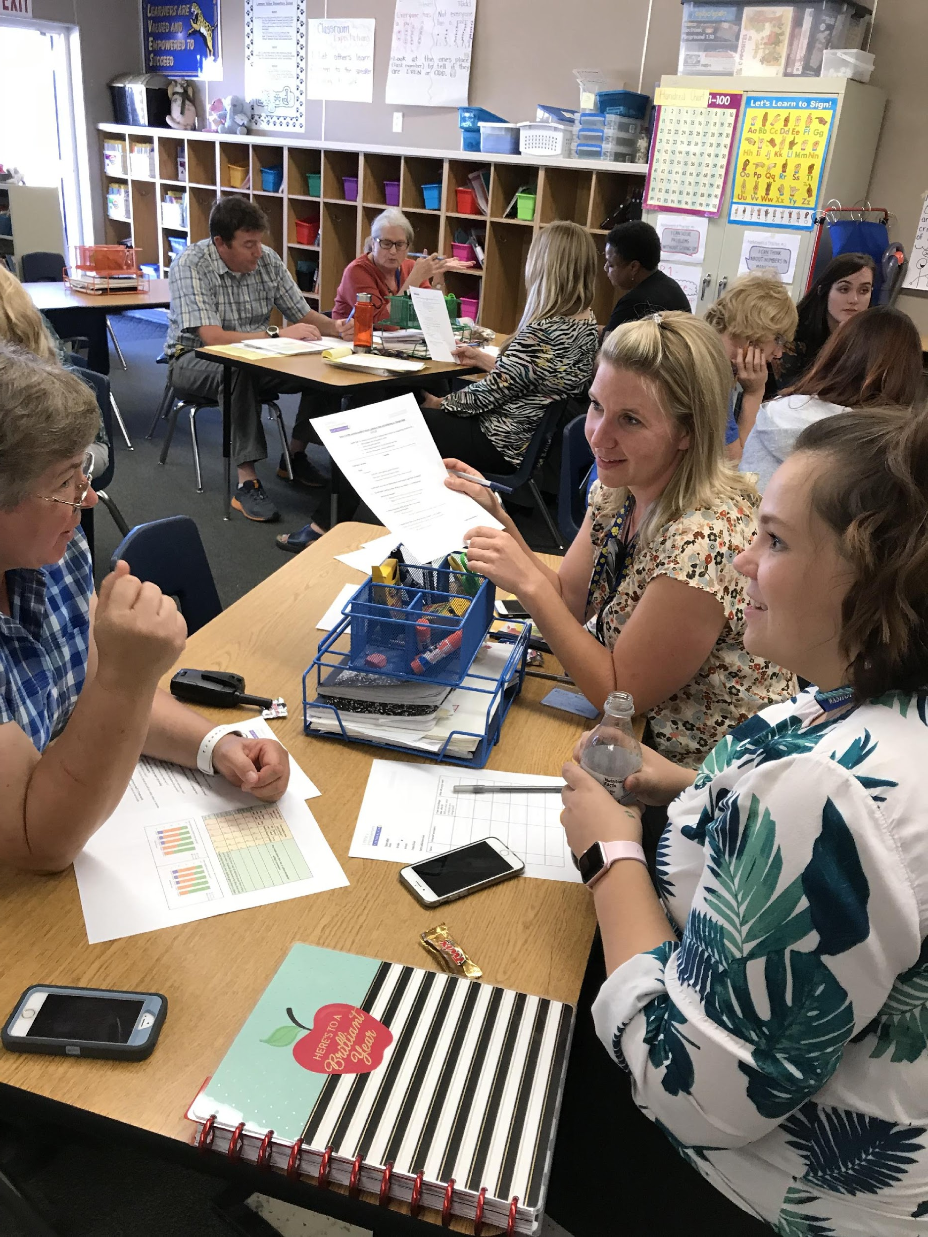
Learning huddles
Learning huddles are short meetings used to support teachers’ improvement of instruction. Learning huddles are the “engine” of the inquiry cycle and focus the group’s efforts on common problems and solutions in practice.

Slide 76
Learning huddles
Learning huddles are …
Short (30–45 minutes, fitting within a typical meeting time).
Focused on a specific topic and aim.
Guided by agenda and roles.
Equitable (everyone shares).
Autonomous (teacher-facilitated).
Embedded in an inquiry cycle (not stand-alone).
Focused on using research-based classroom practices.
Planned to result in clear next steps.

Slide 77
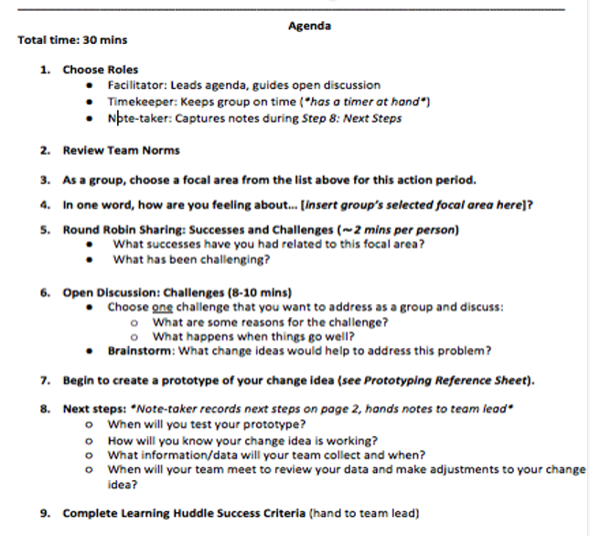
Learning huddle agendas
Review and reflect on the example learning huddle agenda.
Pair share:
What routines do you see?
What is the huddle trying to accomplish?
Which step might be challenging for a group?
Notes:
Tell participants to review the agenda in their workbook. Take some notes in response to the questions, and then discuss with a partner.

Slide 78
Different types of learning huddles
Learning huddles are embedded in an inquiry cycle, focused on a specific topic or aim, and used to facilitate a variety of conversations, including:
Planning for inquiry.
Problem identification.
Prototyping change ideas.
Determining measures and data collection processes.
Analyzing data.
Consolidating learning.
Notes:
You can invite participants to think about the learning huddle example in the previous slide and ask what that huddle was trying to accomplish.

Slide 79
Learning huddle pitfalls
One person is dominating the discussion.
Discussion goes off track.
The group is not prepared with data.
Teachers skip over the data or take only a cursory look at their data.
Data are not disaggregated, or there is no attention to patterns of inequity.
Change ideas are not clear, specific, right-sized, or actionable.
The group has not articulated clear next steps.

Slide 80
Learning huddle pitfalls
Pair share:
Choose one pitfall. What would you do before, during, or after a learning huddle to address this issue?
One person is dominating the discussion.
Discussion goes off track.
The group is not prepared with data.
Teachers skip over the data or take only a cursory look at their data.
Change ideas are not clear, specific, right-sized, or actionable.
The group has not articulated clear next steps.

Slide 81
Learning huddle self-check
A learning huddle is a meeting, but not every meeting is a learning huddle. When planning learning huddles, make sure that they meet all of these requirements:
Short (30–45 minutes, fitting within a typical meeting time).
Focused on a specific topic.
Guided by agenda and roles.
Equitable (everyone shares).
Autonomous (teacher-facilitated).
Embedded in an inquiry cycle (not stand-alone).
Aligned to research-based practice.
Clear next steps.

Slide 82
Self-reflection
How are you currently thinking about leading and facilitating improvement work?
What specific strategies from this module do you plan to incorporate into your practice?
Notes:
Provide a few minutes for individual reflection and then ask if anyone would like to share their response with the group.
Reiterate and expand some of the key points of the module as participants share responses.

Slide 83
Next steps

Slide 84
Module review
During this module our learning targets were to …
Understand the role of the facilitator in leading improvement work.
Leading improvement work.
Learn about some key strategies for facilitating and developing teams.
Team development.
Promoting positive group dynamics.
Learn about some key routines and structures for continuous improvement.
Meeting planning and facilitation.
Meeting routines in action: learning huddles.
Notes:
As you review the module content, mention some of the key points.
Key points:
• It is worth the time and effort to lay groundwork for productive discussions by building strong teams and promoting positive group dynamics.
• Establishing expectations for collaboration and following simple but set routines will allow teachers to focus on content in a safe environment.

Slide 85
Action period for Module 3
Identify a team to work with.
Optional: identify potential team leads.
Begin to create a structure for your improvement work documents.
Plan and conduct an initial team meeting.
Assess the current systems you will be working in:
Develop community agreements.
Discuss anticipated challenges.
Schedule meetings.
Get a baseline for your team dynamics:
Use the meeting success criteria.
Notes:
Review the action period activities with the group, and make sure to answer any questions.

Slide 86
Closing reflection
Please share:
What is one new idea or learning you are leaving with today?
Notes:
Have people share aloud during in-person settings or in the chat for online participation.
This is also an opportunity to include a feedback survey.

Slide 87
References
Anaissie, T., Cary, V., Clifford, D., Malarkey, T., & Wise, S. (2021, June 7). Creative Commons Equity-centered design framework. Stanford d.school. Retrieved December 17, 2021, from https://dschool.stanford.edu/resources/equity-centered-design-framework
Barth, R. (2002). The culture builder. Educational Leadership, 59(8), 6–11. Retrieved December 28, 2021, from https://www.ascd.org/el/articles/the-culture-builder
Bay Area Coalition for Equitable Schools (BayCES). (2004). A guide to data-based inquiry: Using the cycle to drive learning and change for equity. BayCES, Oakland, CA.
Boston Consulting Group (2014). Teachers know best: Teachers’ views on professional development. Seattle, WA: Bill and Melinda Gates Foundation.
Both, T., & Baggereor, D. (2020, April 30). Design thinking bootcamp bootleg. Stanford, CA: Stanford d.school. https://dschool.stanford.edu/resources/the-bootcamp-bootleg
Bowman, A. (2011). Sphere of success [Activity]. National Equity Project, Oakland, CA.
Bowman, A. (2012). Things people say [Activity]. Alliance Learning Solutions.
Bowman, A., Dolle, J., & Takahashi, S. (2019). Improvement Science Institute [Presentation]. San Francisco, CA: WestEd.
Bryk, A., Gomez, L. M., Grunow, A., & LeMahieu, P. G. (2015). Learning to improve: How America’s schools can get better at getting better. Cambridge, MA: Harvard Education Press.
Bryk, A., Sebring, P. B., Allensworth, E., Luppescu, S., & Easton, J. Q. (2010). Organizing schools for improvement: Lessons from Chicago. Chicago, IL: University of Chicago Press.
Carnegie Foundation for the Advancement of Teaching, https://www.carnegiefoundation.org, retrieved April 22, 2021.
Center on School Turnaround. (2017). Four domains for rapid school improvement: A systems framework. San Francisco, CA: The Center for School Turnaround at WestEd.
Council of Chief State School Officers. (2013, April). InTASC Model Core Teaching Standards and Learning Progressions for Teachers 1.0: A resource for ongoing teacher development. Washington, DC: CCSSO.
Cristol, K., & Ramsey, B. S. (2014). Common Core in the districts: An early look at early implementers. Washington, DC: Thomas Fordham Institute.

Slide 88
References
Dana, N. F. (2014). The reflective educator's guide to classroom research: Learning to teach and teaching to learn through practitioner inquiry. Thousand Oaks, CA: Corwin Press.
Dechurch, L., Mesmer-Magnus, J., & Doty, D. (2013). Moving beyond relationship and task conflict: Toward a process-state perspective. Journal of Applied Psychology, 98(4), 559–578. https://doi.org/10.1037/a0032896
Desimone, L., Smith, T. M., & Ueno, K. (2006, April). Are teachers who need sustained, content-focused professional development getting it? An administrator’s dilemma. Educational Administration Quarterly, 42(2), 179–215.
Desimone, L. M. (2009, April 1). Improving impact studies of teachers’ professional development: Toward better conceptualizations and measures. Educational Researcher, 38(3), 181–199. https://journals.sagepub.com/stoken/rbtfl/hYeKyHG/tlbNA/full
Ermeling, B. A. (2009, February 2). Tracing the effects of teacher inquiry on classroom practice. Teaching and Teacher Education, 26(3), 377–388. https://doi.org/10.1016/j.tate.2009.02.019
Fong, P. (2020, December). Now is the time for teachers to use data-based inquiry cycles. Insights & Impact. REL West at WestEd. Retrieved December 28, 2021, from https://www.wested.org/wested-insights/rel-west-data-based-inquiry-cycles/#.
Graham, S., Bollinger, A., Booth Olson, C., D’Aoust, C., MacArthur, C., McCutchen, D., & Olinghouse, N. (2012). Teaching elementary school students to be effective writers: A practice guide (NCEE 2012- 4058). Washington, DC: National Center for Education Evaluation and Regional Assistance, Institute of Education Sciences, U.S. Department of Education. Retrieved from http://ies.ed.gov/ncee/ wwc/publications_reviews.aspx#pubsearch.
Grossman, P., Loeb, S., Cohen, J., Hammerness, K., Wyckoff, J., Boyd, D., et al. (2010). Measure for measure: The relationship between measures of instructional practice in middle school English language arts and teachers’ value-added scores. Cambridge, MA: National Bureau of Economic Research.
Gunrow, A, & Park, S. (2017). Creative Commons Improvement Science Coaching [Presentation]. Licensed by C.C. BY-NC-SA.
Gürdür, D., & Törngren, M. (2018). Visual analytics for cyber-physical systems development: Blending design thinking and systems thinking. Stockholm, Sweden: NordDesign, Department of Machine Design, KTH Royal Institute of Technology.
Hamilton, L., Halverson, R., Jackson, S., Mandinach, E., Supovitz, J., & Wayman, J. (2009). Using student achievement data to support instructional decision making (NCEE 2009-4067). Washington, DC: National Center for Education Evaluation and Regional Assistance, Institute of Education Sciences, U.S. Department of Education. Retrieved from https://ies.ed.gov/ncee/wwc/PracticeGuide/12
Heckman, J. (2017, February 6). The Achievement Gap starts at birth. The Heckman Equation. Retrieved September 15, 2021, from https://heckmanequation.org/resource/starts-at-birth/

Slide 89
References
Hough, H. J., Kerbow, D., Bryk, A., Pinnell, G. S., Rodgers, E., Dexter, E., et al. (2012). Assessing teacher practice and development: The case of comprehensive literacy instruction. School Effectiveness and School Improvement: An International Journal of Research, Policy and Practice 24(4). https://doi.org/10.1080/09243453.2012.731004
Hough, H., Willis, J., Gunrow, A., Krausen, K.., Kwon, S., et al. (2017, November). Continuous improvement in practice. Policy Analysis for California Education. https://www.edpolicyinca.org/publications/continuous-improvement-practice
Kana, J., Kramer, M., & Senge, P. (2021, July 8). The water of systems change. FSG. Retrieved December 17, 2021, from https://www.fsg.org/publications/water_of_systems_change
Kegan, R., & Lahey, L. L. (2001). How the way we talk can change the way we work: Seven languages for transformation. San Francisco, CA: Jossey-Bass.
Langley, G. J., Moen, R., Nolan, K. M., Nolan, T. W., Norman, C. L., & Provost, L. P. (2009). The Improvement Guide. John Wiley & Sons.
Lipton, L., & Wellman, B. M. (2012). Got data? Now what?: Creating and leading cultures of inquiry. Bloomington, IN: Solution Tree Press.
National Equity Project, https://www.nationalequityproject.org/, retrieved December 20, 2020.
Read, J. D. (1983). Detection of Fs in a single statement: The role of phonetic recoding. Memory & Cognition, 11(4), 390–399. https://doi.org/10.3758/bf03202454
Tuckman, Bruce W. (1965). Developmental sequence in small groups. Psychological Bulletin, 63, 384–399.
Valdez, A., Takahashi, S., Krausen, K., Bowman, A., & Gurrola, E. (2020). Getting better at getting more equitable: Opportunities and barriers for using continuous improvement to advance educational equity. San Francisco, CA: WestEd.
Weisberg, A. (2019, January 29). How to conduct needs assessment part 1: What is it and why do it? NC State Industry Expansion Solutions. Retrieved December 17, 2021, from https://www.ies.ncsu.edu/blog/how-to-conduct-needs-assessment-part-1-what-is-it-and-why-do-it/

