Slide 1
Facilitating Improvement in Teacher Practice
Learning Module 7
Engaging in Inquiry Cycles

Slide 2
Acknowledgments
This module series includes work that has been adapted from successful strategies developed by Alicia Bowman and Kim Austin for the Regional Educational Laboratory West (REL West) at WestEd.
We would like to acknowledge the Center for the Collaborative Classroom and Washoe County School District for their partnership in this work. We would also like to acknowledge the Carnegie Foundation for the Advancement of Teaching for its contributions to the field that are cited in this work.
Citation: Bowman, A., & Austin, K. (2021). Facilitating Improvement Professional Learning Modules— Module 7: Engaging in inquiry cycles [Slide deck]. Washington, DC: U.S. Department of Education, Institute of Education Sciences, National Center for Education Evaluation and Regional Assistance, Regional Educational Laboratory West.
This product was funded under Contract ED-IES-17-C-0012 by Regional Educational Laboratory West administered by WestEd. The content does not necessarily reflect the views or policies of the Institute of Education Sciences or the U.S. Department of Education, nor does mention of trade names, commercial products, or organizations imply endorsement by the U.S. government.

Slide 3
Welcome
Notes:
We recommend that you include a slide to introduce any new members of the facilitation team or participants

Slide 4
Community agreements
(Developed by the cohort in Module 1)
Notes:
Review the community agreements that you developed together during Module 1.
Ask participants to identify an agreement for themselves that they would like to focus on for the day. They do not need to share what they selected.

Slide 5
Progress check-in
Introductions (name/role, if needed)
(2 minutes) Round robin check-in:
In one word, how are you feeling today?
(8 minutes) Progress checks:
Since our last session, what have you been working on?
Has anything changed that impacts your work?
How is the group dynamic of your team? (meeting success criteria)
Closing.
Notes:
Ask participants if this progress check-in is starting to feel routine now. Ask them if they have established any routines like this with their teams and how those have been received.

Slide 6
Learning arc for modules
Notes:
Remind participants that in the previous several sessions, they have learned about using data and evidence to define a problem, challenged assumptions as they conducted a root cause analysis, and started prototyping a change idea. The next step is to iteratively test and improve the prototype.

Slide 7
Improvement questions
We have four key improvement questions to improve our work:
1. What are our priority needs?
2. What is the problem we are trying to solve?
3. What might we change or introduce, and why?
4. How will we test and build confidence in our changes?
Source: Adapted from Langley (2009).
Notes:
This module on interative testing of a prototype begins to answer the fourth improvement question.

Slide 8
Learning targets
Reflect on how inquiry cycles can help your team learn.
Understand the steps of the inquiry cycle process.
Consider how to build confidence in changes and adopt new practices.
Notes:
As you describe the learning targets, mention some of the key points.
Key points:
• Rapid cycles help educators take intentional and disciplined action toward resolving systemic problems, reflect on their actions, and take new action based on those reflections.
• A PDSA (Plan-Do-Study-Act) cycle is a four-stage, problem-solving model used to test a prototype for change.
• Learning huddles are a type of inquiry meeting intentionally designed for one of three purposes: to understand a problem, identify changes and plan prototyping, or study results.

Slide 9
Topics
Engaging in inquiry cycles.
Introduction to Plan-Do-Study-Act cycles (PDSAs).
Building confidence in changes.

Slide 10
Engaging in inquiry cycles

Slide 11
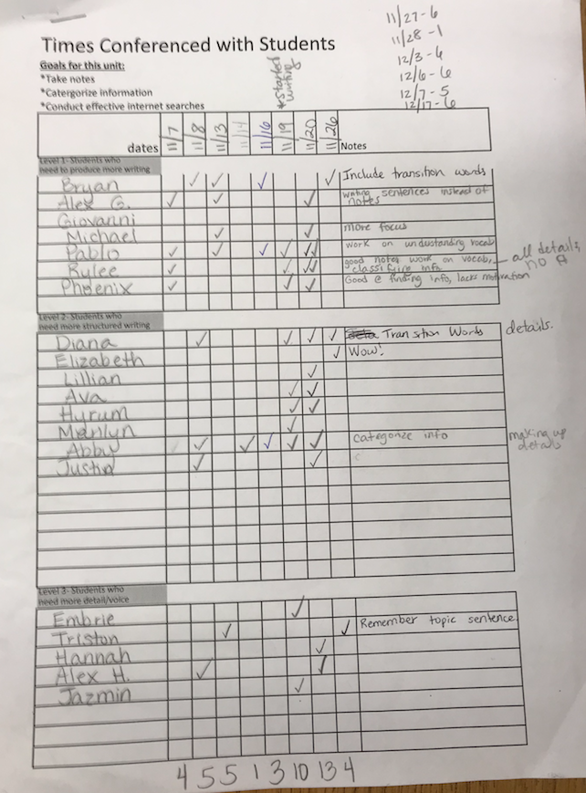
An improvement story: Lemmon Valley 3rd grade team
The 3rd grade team at Lemmon Valley Elementary School tested and refined their prototype over several months.
The team’s initial goal was to increase the number of writing conferences. As they tested their first conference tracker, they grouped students by reading level or past writing (low, medium, high), and tallied the total number of conferences for each student.
After this first test, they met to reflect on the data they collected and to refine their tracker for further testing.
Conference tracker with data
Notes:
As an alternative to using the slides or to use in addition to the slides, participants can watch or rewatch the video Learning to Improve Instruction: One Team’s Story, https://youtu.be/icO9IkmXurw, which describes the Lemmon Valley improvement journey.

Slide 12
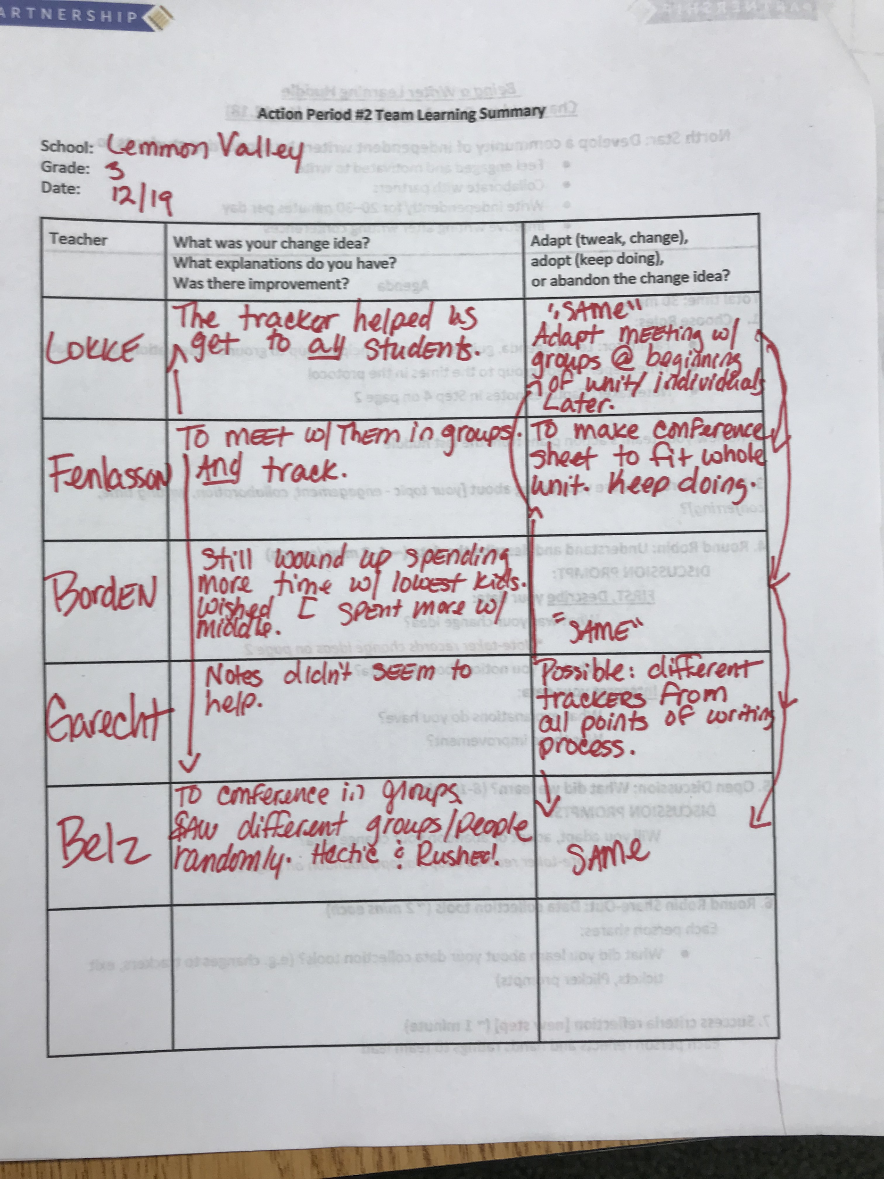
An improvement story: Lemmon Valley 3rd grade team
The team used an action cycle learning summary to record the results of testing the conference tracker.
They found that the conference tracker did help them to meet with each of their students.
The team found that they met more frequently with students who needed more help.
Action cycle learning summary
Notes:
In this example, the team members reflected on the change idea they agreed to try, whether it was helpful or not, and why they thought they got the results they did. Overall, they found that the conference tracker helped them to meet with their students.

Slide 13
An improvement story: Lemmon Valley 3rd grade team
They also brainstormed ideas for adaptations to their tracker and conferencing process, including …
Initial conference in groups with follow-up conferences by individual student.
Different trackers for different points in the writing process or one to fit the whole unit.
Action cycle learning summary
Notes:
Then the tam shared whether the change idea should be adopted as is, adapted to improve it, or abandoned in favor of something else. In this case, the team came up with several adaptations to improve the conference tracker.

Slide 14
Self-reflection
How was it helpful for the team to document their learning about the conference tracker?
What structures do you use to support reflection and document your team’s progress?
Notes:
Provide a few minutes for individual reflection in the workbook and then ask if anyone would like to share their response with the group. If no one mentions it, tell participants that with iterative inquiry cycles, it will be important to document what worked, for whom, and how that informed the next iteration.

Slide 15
Rapid cycles of improvement
Rapid cycles of improvement are a series of inquiry cycles used to test a particular change, in order to improve an overall system.
Notes:
Testing a prototype once is insufficient to build confidence that a change will work in different contexts. Rapid cycles allow you to test a change multiple times under varied conditions, learn from the tests, and continue to improve the change.

Slide 16
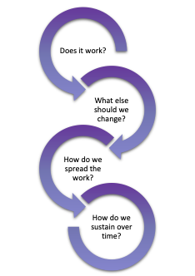
Rapid cycles of improvement
Iterative rapid cycles of improvement help us learn what it will take to create lasting change.
Source: Adapted from Bowman, Dolle, & Takahashi (2019) and Carnegie Foundation for the Advancement of Teaching (2021).

Slide 17
Rapid cycles of improvement
Keep teams focused over time on key challenges and inequities.
Generate deeper learning about how to address these challenges.
Help educators make informed changes in their practice.
Promote improved collaborative relationships between teachers.
Notes:
Rapid cycles can quickly surface places where improvement is or is not happening to address inequities, enabling the team to adjust their approach in real time instead of waiting until the end of a unit, semester, or year.

Slide 18
Rapid cycles of improvement
Rapid cycles are intended to be embedded in regular practice and allow educators to learn while doing.
They help educators take intentional and disciplined action toward resolving systemic problems, reflect on their actions, and take new action based on those reflections.

Slide 19
Understanding why you are improving
Which “L” are you?
Lucky | Leading
Lost | Learning
Strength of your results
Understanding why you got your results
Source: National Equity Project (2020).
Notes:
Getting poor results and not understanding how you got them is the lost quadrant. Getting strong results without understanding why means you are lucky. This often happens when you have multiple initiatives happening at the same time and can't tell what actually made an improvement (spray and pray).
Getting poor results but understanding why they are poor means you are learning.
What we are all striving for is the leading quadrant, strong results with a clear understanding of why we are getting those results.

Slide 20
Self-reflection
Can you think of a time when you saw improvement in an outcome but did not know exactly what caused it?
Were you able to replicate the success?
Notes:
Provide a few minutes for individual reflection in the workbook and then ask if anyone would like to share their response with the group. As they share, you can ask in which quadrant their example would be.
Tell participants that we will learn about Plan-Do-Study-Act cycles, one form of purposeful, rapid cycle inquiry. PDSAs keep teams in the learning and leading quadrants.

Slide 21
Introduction to PDSAs

Slide 22
What is a PDSA?
A PDSA (Plan-Do-Study-Act) cycle is an engine for learning.
This four-stage, problem-solving model is used to test a prototype for change.
ACT
Next steps: adapt, adopt, abandon.
PLAN
What’s your change?
What are your predictions?
What data will you collect?
Plan to conduct test.
STUDY
Compare results to predictions.
What did you learn?
DO
Execute test.
Collect data, document observations.
Source: Adapted from Bowman, Dolle, & Takahashi (2019) and Carnegie Foundation for the Advancement of Teaching (2021).
Notes:
A PDSA cycle consists of four parts. The first part is to develop a plan. While you plan, you also make predictions of what the outcomes will be and design a test for your prototype and determine your data and measures of success. Depending on the complexity of the plan, this may take more than one meeting. The second part is to carry out your plan and collect data. The third part is to analyze your data with your team and document your learning. And the fourth part is to determine next steps. These next steps could include how you will test the idea further, make adaptations and test again, or abandon the idea and start over.

Slide 23
Improvement questions
We have four key improvement questions to improve our work:
1. What are our priority needs?
2. What is the problem we are trying to solve?
3. What might we change or introduce, and why?
4. How will we test and build confidence in our changes?
Source: Adapted from Langley (2009).
Notes:
This module on interative testing of a prototype begins to answer the fourth improvement question.

Slide 24
What is a PDSA?
A PDSA helps you make your assumptions and hypotheses explicit and surfaces gaps in your understanding.
PLAN
What’s your change?
What are your predictions?
What data will you collect?
Plan to conduct test.
ACT
Next steps: adapt, adopt, abandon.
STUDY
Compare results to predictions.
What did you learn?
DO
Execute test.
Collect data, document observations.
Source: Adapted from Bowman, Dolle, & Takahashi (2019) and Carnegie Foundation for the Advancement of Teaching (2021).
Notes:
The two areas of a PDSA that are key for team collaboration (and are often the steps that are left out) are making predictions before a test and comparing your results to your predictions. In the absence of these, it is easy to base your results on hindsight, rather than being clear about why you got a particular set of results.

Slide 25
PDSAs: A cycle of learning
Ideally, your teams will be continuously engaging in PDSAs or inquiry cycles together to meet the needs of learners in their classrooms and across their team.
Notes:
Explain to participants that as a team moves through the continuous improvement cycles using learning huddles, learning about what works for whom and under what conditions increases. Then teams can begin to answer questions about spreading and scaling an improvement to other grade levels or schools.

Slide 26
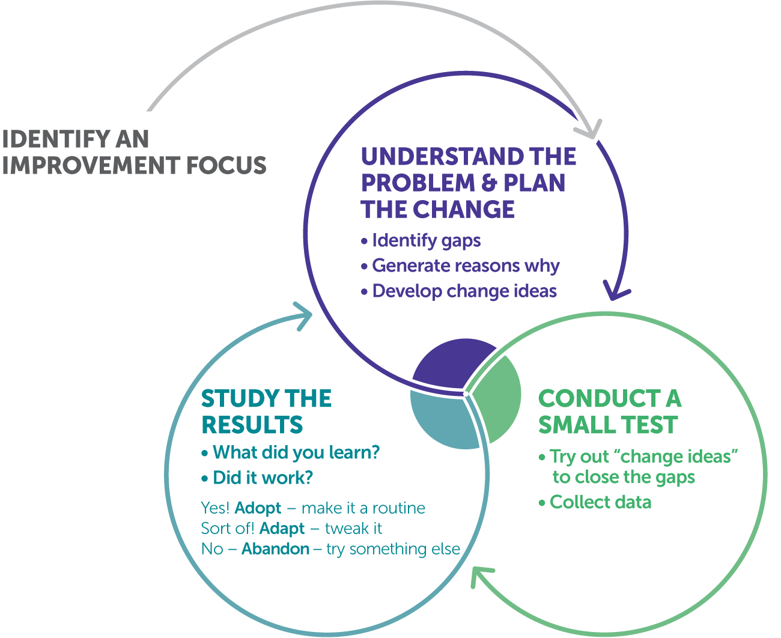
Teacher inquiry cycle
Teacher teams complete rapid cycles using a Plan-Do- Study-Act process.
Plan (huddle)
Do
Act
Study (huddle)
Notes:
Explain to participants that the improvement focus may be identified by leadership, such as a principal or district staff, in advance based on data and other evidence, or by the improvement team—for example, the grade-level team, as in the Lemmon Valley example.
Then the PDSA begins. Point out the plan, do, study, and act portions of the cycle. It aligns with the four improvement questions we have been using.
What are our priority needs?
What is the problem we are trying to solve?
What might we change or introduce, and why?
How will we trust and build confidence in our changes?

Slide 27
Learning huddles
Learning huddle protocols build in processes that help guide a team through the inquiry cycle.
Learning huddle
(plan the change)
Learning huddle
(study the results)
Action period
(test the prototype)
Notes:
Explain to participants that there are routines or huddle protocols associated with various parts of the cycle.

Slide 28
Learning huddles work in a sequence
Huddle #1: understand the problem.
Learning huddles 1 & 2
(plan the change)
Huddle #2: identify change ideas and develop prototypes.
Learning huddle 3
(study the results)
Action period: test a prototype.
Action period
(test the prototype)
Huddle #3: study the results of the test and determine next steps.
Notes:
Tell participants that there are different learning huddle protocols for each step of the inquiry cycle.

Slide 29
Learning huddles review
A learning huddle is a meeting, but not every meeting is a learning huddle. When planning learning huddles, make sure that they meet all these requirements:
Short (30–45 minutes, fitting within a typical meeting time).
Focused on a specific topic and aim.
Guided by agenda and roles.
Equitable (everyone shares).
Autonomous (teacher-facilitated).
Embedded in an inquiry cycle (not stand-alone).
Focused on using research-based classroom practices.
Result in clear next steps.
Notes:
Remind participants that huddles are a type of structured team meeting. These requirements are consistent across the learning huddles, no matter their purpose. Ask participants to name a couple of types of meetings that they have experienced that are not learning huddles and the purpose of those meetings. Ask: What criteria were missing in those meetings? Make the point that learning huddles are intentionally designed to support the learning for a part of the PDSA cycle.

Slide 30
Planning learning huddles for your team
It’s important to identify the purpose of each learning huddle.
Is the purpose of the huddle (a) to better understand a problem, (b) to identify changes and develop prototypes, or (c) to study the results of something your team has already tried?

Slide 31
Planning learning huddles for your team
Huddles for different purposes will require different tools and processes.
Purpose | Tools and processes
Understand a problem. | Data discussion questions or protocol.
Identify changes and prototyping. | Discussion protocol. Prototyping process.
Study results. | Reflection questions. Note-taking tool.
Notes:
Examples of these generic protocols are in the facilitator's guide and the participants’ workbooks.

Slide 32
Small-group discussion
How do you engage in inquiry cycles with your team?
Which parts of the cycle is it harder to find time for?
How do you document your learning?
Notes:
Provide 10 minutes to share in small groups. Tell participants there is space in their workbook to write notes about their conversation.
When you return to the whole group, ask if there are any highlights from the groups that they would like to share. If relevant to their responses, ask participants if they would consider their meeting a “huddle” and, if so, what kind of huddle.

Slide 33
Building confidence in changes

Slide 34
Building confidence in changes
Multiple iterations of testing help you build confidence in your changes.
As you test changes in practice and collect data, it is important to keep track of what is working and what is not.
Change ideas that are successful should be clearly documented and shared, so they can be tested in a variety of contexts.
Notes:
Tell participants that as they iteratively test and improve upon their prototype, teams get clearer on what works for whom and under what conditions. As teams learn more, they need to document their learning to share with other teams and to create a memory of what was tried and how it did or didn’t work.

Slide 35
What is confidence?
When tested in multiple contexts, “confidence” means that the change consistently ...
Directly addressed the problem.
Resulted in an improved practice, process, or routine.
Consistently improved learning experiences and outcomes for students.
As you build confidence in changes, those changes become promising practices that you can spread and scale.

Slide 36
Understanding why you are improving
Lucky | Leading
Lost | Learning
Strength of your results
Understanding why you got your results
Source: National Equity Project (2020)
Notes:
Remind participants that they want to be in the leading and learning quadrants, not the lost or even the lucky quadrants. Replicating, scaling, and sustaining a change requires knowledge of what made it work in the first place.

Slide 37
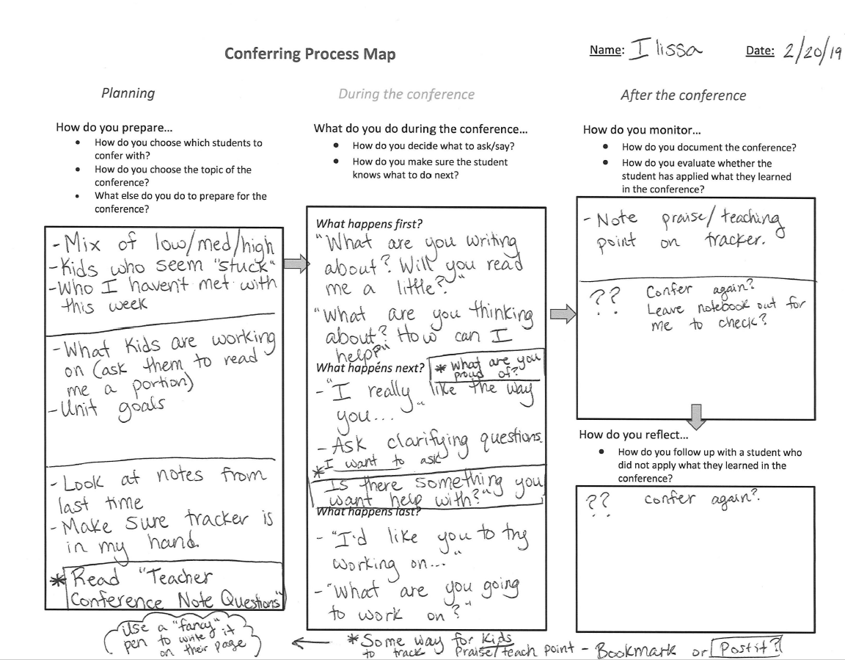
An improvement story: Lemmon Valley 3rd grade team
The team built confidence in their conference tracker because all teachers were able to meet regularly with all students—their first goal.
Now they wanted to be sure that their conferences were effective. They used a process map to surface issues and gaps in their current conferencing system.
Process map
Notes:
In this process map, teachers thought through what they do to prepare for a writing conference and what they do during and after a conference. As they completed the process map, they noticed some gaps in their practice, and some questions were surfaced. For example, some teachers didn’t have a step for following up with students after a conference.
Ask participants for some other ways they currently reflect on their practice. How do they identify gaps?

Slide 38
Equity pause
EQUITY
PAUSE
The team in our improvement story is now successfully meeting with all students throughout the week. They met their goal but continued to look at their practice.
What assumptions could have been made by the team after they met their initial goal? Why was a deeper look at their practice important for equitable outcomes for their students?
Can you think of a promising practice that you have built confidence in that addressed the needs of each student?
Notes:
Provide 1–2 minutes of individual reflection in the workbook. Then this equity pause can be a small-group or whole-group discussion, depending on the size of your group. It is important that the discussion groups are small enough for everyone to be able to participate.
What might have happened if the team stopped with the first version of their conference tracking sheet?

Slide 39
Next steps

Slide 40
Module review
During this module, our learning targets were to …
Reflect on how inquiry cycles can help your team learn.
Engaging in inquiry cycles.
Understand the steps of the inquiry cycle process.
Introduction to PDSAs.
Consider how to build confidence in changes and adopt new practices.
Building confidence in changes.
Notes:
As you review the module, repeat the key points:
• Rapid cycles help educators take intentional and disciplined action toward resolving systemic problems, reflect on their actions, and take new action based on those reflections.
• A PDSA (Plan-Do-Study-Act) cycle is a four-stage, problem-solving model used to test a prototype for change.
• Learning huddles are a type of inquiry meeting intentionally designed for one of three purposes: understanding a problem, identifying changes and plan prototyping, or studying results.

Slide 41
Action period work
Plan a team learning huddle to identify change ideas and develop prototypes.
Create a plan to test your prototype.
Make predictions about the test.
Include an equity pause in your huddle to check for assumptions.
Use meeting success criteria to monitor team dynamics.
Anticipate places where you may encounter and need to shift unproductive discourse.
Have team members test the prototype and document their learning from the test.
Notes:
Review the action period activities with the group and make sure to answer any questions.

Slide 42
Closing reflection
Please share:
What are you thinking about focusing on next to continue this work?
Notes:
Have people share aloud during in-person settings or in the chat for online participation.
Ask participants to complete the session feedback form before they leave.

Slide 43
References
Anaissie, T., Cary, V., Clifford, D., Malarkey, T., & Wise, S. (2021, June 7). Creative Commons Equity-centered design framework. Stanford d.school. Retrieved December 17, 2021, from https://dschool.stanford.edu/resources/equity-centered-design-framework
Barth, R. (2002). The culture builder. Educational Leadership, 59(8), 6–11. Retrieved December 28, 2021, from https://www.ascd.org/el/articles/the-culture-builder
Bay Area Coalition for Equitable Schools (BayCES). (2004). A guide to data-based inquiry: Using the cycle to drive learning and change for equity. BayCES, Oakland, CA.
Boston Consulting Group (2014). Teachers know best: Teachers’ views on professional development. Seattle, WA: Bill and Melinda Gates Foundation.
Both, T., & Baggereor, D. (2020, April 30). Design thinking bootcamp bootleg. Stanford, CA: Stanford d.school. https://dschool.stanford.edu/resources/the-bootcamp-bootleg
Bowman, A. (2011). Sphere of success [Activity]. National Equity Project, Oakland, CA.
Bowman, A. (2012). Things people say [Activity]. Alliance Learning Solutions.
Bowman, A., Dolle, J., & Takahashi, S. (2019). Improvement Science Institute [Presentation]. San Francisco, CA: WestEd.
Bryk, A., Gomez, L. M., Grunow, A., & LeMahieu, P. G. (2015). Learning to improve: How America’s schools can get better at getting better. Cambridge, MA: Harvard Education Press.
Bryk, A., Sebring, P. B., Allensworth, E., Luppescu, S., & Easton, J. Q. (2010). Organizing schools for improvement: Lessons from Chicago. Chicago, IL: University of Chicago Press.
Carnegie Foundation for the Advancement of Teaching, https://www.carnegiefoundation.org, retrieved April 22, 2021.
Center on School Turnaround. (2017). Four domains for rapid school improvement: A systems framework. San Francisco, CA: The Center for School Turnaround at WestEd.
Council of Chief State School Officers. (2013, April). InTASC Model Core Teaching Standards and Learning Progressions for Teachers 1.0: A resource for ongoing teacher development. Washington, DC: CCSSO.
Cristol, K., & Ramsey, B. S. (2014). Common Core in the districts: An early look at early implementers. Washington, DC: Thomas Fordham Institute.

Slide 44
References
Dana, N. F. (2014). The reflective educator's guide to classroom research: Learning to teach and teaching to learn through practitioner inquiry. Thousand Oaks, CA: Corwin Press.
Dechurch, L., Mesmer-Magnus, J., & Doty, D. (2013). Moving beyond relationship and task conflict: Toward a process-state perspective. Journal of Applied Psychology, 98(4), 559–578. https://doi.org/10.1037/a0032896
Desimone, L., Smith, T. M., & Ueno, K. (2006, April). Are teachers who need sustained, content-focused professional development getting it? An administrator’s dilemma. Educational Administration Quarterly, 42(2), 179–215.
Desimone, L. M. (2009, April 1). Improving impact studies of teachers’ professional development: Toward better conceptualizations and measures. Educational Researcher, 38(3), 181–199. https://journals.sagepub.com/stoken/rbtfl/hYeKyHG/tlbNA/full
Ermeling, B. A. (2009, February 2). Tracing the effects of teacher inquiry on classroom practice. Teaching and Teacher Education, 26(3), 377–388. https://doi.org/10.1016/j.tate.2009.02.019
Fong, P. (2020, December). Now is the time for teachers to use data-based inquiry cycles. Insights & Impact. REL West at WestEd. Retrieved December 28, 2021, from https://www.wested.org/wested-insights/rel-west-data-based-inquiry-cycles/#.
Graham, S., Bollinger, A., Booth Olson, C., D’Aoust, C., MacArthur, C., McCutchen, D., & Olinghouse, N. (2012). Teaching elementary school students to be effective writers: A practice guide (NCEE 2012- 4058). Washington, DC: National Center for Education Evaluation and Regional Assistance, Institute of Education Sciences, U.S. Department of Education. Retrieved from http://ies.ed.gov/ncee/ wwc/publications_reviews.aspx#pubsearch.
Grossman, P., Loeb, S., Cohen, J., Hammerness, K., Wyckoff, J., Boyd, D., et al. (2010). Measure for measure: The relationship between measures of instructional practice in middle school English language arts and teachers’ value-added scores. Cambridge, MA: National Bureau of Economic Research.
Gunrow, A, & Park, S. (2017). Creative Commons Improvement Science Coaching [Presentation]. Licensed by C.C. BY-NC-SA.
Gürdür, D., & Törngren, M. (2018). Visual analytics for cyber-physical systems development: Blending design thinking and systems thinking. Stockholm, Sweden: NordDesign, Department of Machine Design, KTH Royal Institute of Technology.
Hamilton, L., Halverson, R., Jackson, S., Mandinach, E., Supovitz, J., & Wayman, J. (2009). Using student achievement data to support instructional decision making (NCEE 2009-4067). Washington, DC: National Center for Education Evaluation and Regional Assistance, Institute of Education Sciences, U.S. Department of Education. Retrieved from https://ies.ed.gov/ncee/wwc/PracticeGuide/12
Heckman, J. (2017, February 6). The Achievement Gap starts at birth. The Heckman Equation. Retrieved September 15, 2021, from https://heckmanequation.org/resource/starts-at-birth/

Slide 45
References
Hough, H. J., Kerbow, D., Bryk, A., Pinnell, G. S., Rodgers, E., Dexter, E., et al. (2012). Assessing teacher practice and development: The case of comprehensive literacy instruction. School Effectiveness and School Improvement: An International Journal of Research, Policy and Practice 24(4). https://doi.org/10.1080/09243453.2012.731004
Hough, H., Willis, J., Gunrow, A., Krausen, K.., Kwon, S., et al. (2017, November). Continuous improvement in practice. Policy Analysis for California Education. https://www.edpolicyinca.org/publications/continuous-improvement-practice
Kana, J., Kramer, M., & Senge, P. (2021, July 8). The water of systems change. FSG. Retrieved December 17, 2021, from https://www.fsg.org/publications/water_of_systems_change
Kegan, R., & Lahey, L. L. (2001). How the way we talk can change the way we work: Seven languages for transformation. San Francisco, CA: Jossey-Bass.
Langley, G. J., Moen, R., Nolan, K. M., Nolan, T. W., Norman, C. L., & Provost, L. P. (2009). The Improvement Guide. John Wiley & Sons.
Lipton, L., & Wellman, B. M. (2012). Got data? Now what?: Creating and leading cultures of inquiry. Bloomington, IN: Solution Tree Press.
National Equity Project, https://www.nationalequityproject.org/, retrieved December 20, 2020.
Read, J. D. (1983). Detection of Fs in a single statement: The role of phonetic recoding. Memory & Cognition, 11(4), 390–399. https://doi.org/10.3758/bf03202454
Tuckman, Bruce W. (1965). Developmental sequence in small groups. Psychological Bulletin, 63, 384–399.
Valdez, A., Takahashi, S., Krausen, K., Bowman, A., & Gurrola, E. (2020). Getting better at getting more equitable: Opportunities and barriers for using continuous improvement to advance educational equity. San Francisco, CA: WestEd.
Weisberg, A. (2019, January 29). How to conduct needs assessment part 1: What is it and why do it? NC State Industry Expansion Solutions. Retrieved December 17, 2021, from https://www.ies.ncsu.edu/blog/how-to-conduct-needs-assessment-part-1-what-is-it-and-why-do-it/

