Slide 1
Facilitating Improvement in Teacher Practice
Learning Module 6
Prototyping Change Ideas

Slide 2
Acknowledgments
This module series includes work that has been adapted from successful strategies developed by Alicia Bowman and Kim Austin for the Regional Educational Laboratory West (REL West) at WestEd.
We would like to acknowledge the Center for the Collaborative Classroom and Washoe County School District for their partnership in this work. We would also like to acknowledge the Carnegie Foundation for the Advancement of Teaching for its contributions to the field that are cited in this work.
Citation: Bowman, A., & Austin, K. (2021). Facilitating Improvement Professional Learning Modules— Module 4: Needs assessment and problem identification [Slide deck]. Washington, DC: U.S. Department of Education, Institute of Education Sciences, National Center for Education Evaluation and Regional Assistance, Regional Educational Laboratory West.
This product was funded by the Institute of Education Sciences (IES) under Contract ED-IES-17-C-0012 by Regional Educational Laboratory West administered by WestEd. The content does not necessarily reflect the views or policies of IES or the U.S. Department of Education, nor does mention of trade names, commercial products, or organizations imply endorsement by the U.S. government.

Slide 3
Welcome
Notes:
We recommend that you include a slide to introduce the facilitation team. This is also where you can build in an opportunity for participant introductions.

Slide 4
Community agreements
(Developed by the cohort in Module 1)
Notes:
Review the community agreements that you developed together during Module 1. Remind participants that in the last session we talked about productive and unproductive discourse. Ask if any of these agreements help support productive discourse. Ask participants to identify an agreement for themselves that they would like to focus on for the day that will help them or others use productive discourse. They do not need to share what they selected.

Slide 5
Progress check-in
Introductions (name/role, if needed).
(2 minutes) Round robin check-in:
In one word, how are you feeling today?
(8 minutes) Progress checks:
Since our last session, what have you been working on?
Has anything changed that impacts your work?
How is the group dynamic of your team? (meeting success criteria)
Closing.
Notes:
In small groups, ask each table to have a progress check-in.

Slide 6
Learning arc for modules
Notes:
Remind participants of where they are in the improvement cycle. They have a problem and have completed the root cause analysis. Now, they are ready to select a change idea.

Slide 7
Improvement questions
We have four key improvement questions to improve our work:
1. What are our priority needs?
2. What is the problem we are trying to solve?
3. What might we change or introduce, and why?
4. How will we test and build confidence in our changes?
Source: Adapted from Langley (2009).
Notes:
The focus on selecting a change idea and developing a prototype is related to the third improvement question.

Slide 8
Learning targets
Understand the difference between a change concept, a change idea, and a prototype.
Understand some guidelines for selecting a change idea.
Understand what evidence-based practices are.
Practice developing a prototype.
Notes:
As you describe the learning targets, mention some of the key points.
Key points:
· Change concepts are broad concepts, change ideas are specific work practices or interventions that represent an alteration to how work is currently done, and prototypes are the tangible activities to implement change ideas.
· Teams should seek change ideas that have high impact with a low or reasonable amount of effort. The change should lead to improvement for every student, not just some students (equity pause).
· Care must be taken to be sure that underlying negative assumptions or unproductive discourse does not drive the selection of a change idea or inform the development of a prototype.
· Starting with research or an evidence-based practice or protocol as a change idea is a good way to keep a team focused on objectively addressing the problem.

Slide 9
Topics
Selecting a change idea.
Using evidence-based practice to identify a change idea.
Prototyping.

Slide 10
Selecting a change idea

Slide 11
What is a change idea?
Change ideas are specific work practices or interventions that represent an alteration to how work is currently done.
Source: Adapted from Bowman, Dolle, & Takahashi (2019).
Notes:
This video may be used in this module to preview or reinforce some of the central ideas: Prototyping Ideas for Change, https://youtu.be/HKK8D7Mu2cI

Slide 12
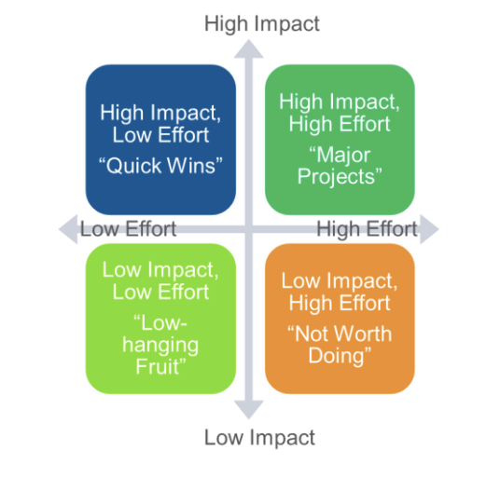
Selecting a change idea
Think about how much effort, time, and resources will be required for different levels of impact.
What quick wins might be within your reach?
Source: Adapted from Bowman, Dolle, & Takahashi (2019).
Notes:
Be prepared with an example of a quick win, something that is high impact but low effort (such as a routine added to an existing meeting). You may choose to have participants reflect individually on the question or ask for individuals to share examples of possible quick wins.

Slide 13
Sources for change ideas
Utilize all available resources to generate change ideas, including …
Available research: scan research for evidence-based solutions.
Practice knowledge: learn from peers or other districts.
Adaptation: adapt a successful solution for a similar issue.
Design/creative thinking: create a new process or tool to fill a gap.
Source: Adapted from Bowman, Dolle, & Takahashi (2019).
Notes:
As you describe each option, have examples of each, but not the examples on the next slide.

Slide 14
Change idea activity
In trios, sort the activities below into their appropriate quadrants.
Discuss why each idea belongs in the quadrant you selected.
Changing the bell schedule to accommodate intervention time.
A process for meeting with students in small groups.
A discussion protocol for students to use with one another.
A new grading process.
A series of thematic field trips to support learning.
A system for personalized learning for students.
Whole-group share-out.
Notes:
Provide 10 minutes to complete the activity in trios. The list is in the participant workbook.
When you return to the whole group, ask if there are any highlights from the groups that they would like to share. Be sure participants explain why they placed the change idea where they did. It is possible for trios to have conflicting answers, depending on a person’s role and the scope of the change (e.g., change the bell schedule across the district or revise the schedule for one grade level at a school). Participants should offer a justification for their answer. There are no right or wrong answers here; the examples are to encourage a discussion.

Slide 15
Common pitfalls when developing change ideas
Identifying a general change concept, but not a specific change idea.
Selecting change ideas that are not changes, but instead are more resources to continue doing the same thing.
Not considering promising practices from others because you are convinced your problem is unique.
Trying to find the perfect solution and never getting started on anything.
Source: Adapted from Bowman, Dolle, & Takahashi (2019) and Carnegie Foundation for the Advancement of Teaching (2021).
Notes:
Identifying a general change concept, but not a specific change idea (e.g., new planning process versus a planning template).
Selecting change ideas that are not changes, but instead are more resources to continue doing the same thing (e.g., funding so we can expand a program that is not showing documented results).
Not considering promising practices from others because you are convinced your problem is unique (not adopting a learning stance and collaborative behavior).
Trying to find the perfect solution and never getting started on anything (spending months to perfect a prototype instead of testing something that will work but isn't perfect).

Slide 16
Reviewing your change idea
Your change idea should …
Address a problem that is regularly occurring.
Be something that will be used regularly (daily/weekly).
Be specific and actionable.
Have a high impact for the effort it takes to implement.

Slide 17
Using evidence-based practice

Slide 18
Evidence-based practice
When selecting change ideas, it is always a good idea to first review the relevant research to see if someone has already developed a possible solution to your problem with some degree of documented success.
Notes:
Explain to participants that one way to avoid fast thinking and to not have assumptions guide your selection of a change idea is to start by reviewing research and evidence. Research doesn’t have to be long research articles in peer-reviewed journals. Evidence-based practice is also found in infographics, research summaries, archived webinars, books, and conference presentations. Ask participants to share places they have looked for evidence-based practices.

Slide 19
Evidence-based practice
Tier 1: Strong Evidence—practices supported by one or more well-designed and well-implemented randomized control experimental studies.
Tier 2: Moderate Evidence—practices supported by one or more well-designed and well-implemented quasi-experimental studies.
Tier 3: Promising Evidence—practices supported by one or more well-designed and well-implemented correlational studies (with statistical controls for selection bias).
Tier 4: Demonstrates a Rationale—practices that have a well-defined logic model or theory of action; are supported by research; and have some effort underway by a state education agency, a local educational agency, or an outside research organization to determine their effectiveness.
Source: Every Student Succeeds Act (ESSA).
Notes:
The Every Student Succeeds Act identifies four tiers for evidence-based practice to support educational institutions to critically examine the solutions they choose to implement. If you are engaging in inquiry as part of a state- or district-sponsored initiative such as a reading improvement grant, you may already be familiar with these tiers.

Slide 20
Using research to identify a change idea
Step 1
Clarify the problem you want your prototype to solve based on your root cause analysis.
Example: Many of our students are chronically absent because they do not have a sense of belonging at the school.
Step 2
Review research to identify evidence-based practices that promote a sense of belonging.
Research suggests that building relationships and understanding what is going on in the students’ lives help build a sense of belonging.
Step 3
Select an evidence-based practice as your change idea that is high leverage and low effort.
Change idea: Regular one-to-one check-ins with students to build relationships.

Slide 21
Evidence-based practice guides
Practice guides from the Institute of Education Sciences’ What Works Clearinghouse (WWC)
Source: WWC, https://ies.ed.gov/ncee/wwc/PracticeGuides.
Notes:
Tell participants that there are nearly 30 practice guides and more on the way. They’re designed for use by educators and include topics from teaching fractions, to using data, to supporting English learners. Each practice guide has a set of research-based recommendations that have been identified by a panel of experts, including researchers and practitioners. And beneath each recommendation, there’s also a set of practices or indicators that, when implemented well, can improve student outcomes. Each guide also has specific classroom examples and ways of overcoming obstacles and roadblocks to implementation.
Note to facilitators: The evidence for a practice guide recommendation goes from “strong” to “moderate” to “minimal.” This corresponds roughly to the tiers of evidence used in the ESSA. The ratings are based on the number of studies, the study design, the nature of the participants in the study relative to the focus of the practice guide, and whether findings are consistently positive, among other criteria. How the ratings are established is explained in each practice guide.

Slide 22
Exploration time
Take 10 minutes to explore one of these practice guides.
Questions to consider:
What do you notice that you want to take a closer look at?
What do you want to bring back to share with your team?
Notes:
Organize participants in trios. Ask them to select a practice guide to review and respond to the questions on the slide, which also appear in their workbook.

Slide 23
Debrief
What did you notice that you want to take a closer look at?
How might you use a practice guide as part of your team’s improvement journey?
Notes:
In the debriefing, emphasize the structure of the practice guides (list of recommendations and practices, strength of the evidence, classroom examples, obstacles and roadblocks to implementation), and ask participants how they might use the practice guides as part of developing change ideas.

Slide 24
Evidence-based practice
Any evidence-based practice you identify as your change idea will likely still need to go through a prototyping process to adapt the practice to your exact problem and context and make it actionable.

Slide 25
Prototyping
Notes:
You may choose to facilitate this section or show the Prototyping Ideas for Change video. You can also do both.
Prototyping Ideas for Change, https://youtu.be/HKK8D7Mu2cI

Slide 26
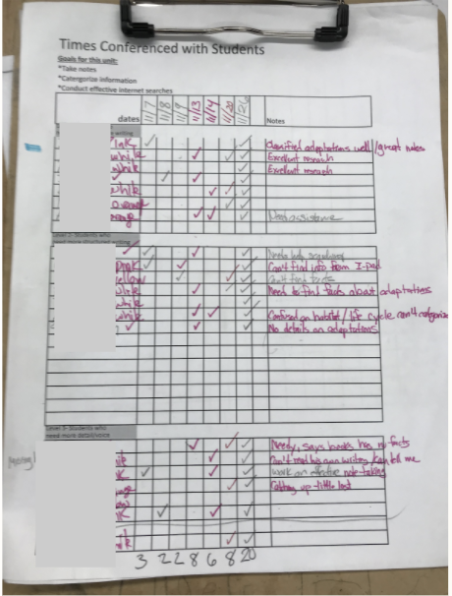
An improvement story: Lemmon Valley 3rd grade team
The 3rd grade team at Lemmon Valley selected the evidence-based practice of consistent writing conferences as their area for improvement. They first realized that they had no practice data to show consistency of conferences in number or frequency.
They decided to …
Choose a conference tracker as a change idea to monitor access to conferences.
Create a common conference tracker to monitor their conferences.
The first of several prototypes

Slide 27
Equity pause
Tools and processes are created in classrooms to meet a specific instructional need, but designers do not always consider the impact of those tools and processes on individual students.
How might a tool or process in a classroom exacerbate inequities for particular students?
How might you support teachers to think about the possible unintended consequences of innovation?
EQUITY
PAUSE
Notes:
This equity pause can be a small-group or whole-group discussion, depending on the size of your group. It is important that the discussion groups are small enough for everyone to be able to participate. Does the tool or process take significant time away from instruction for some students? Is it a process that makes students feel marginalized?

Slide 28
What is a prototype?
A prototype is an early sample or model built to test a concept or process.
Prototyping is one of the fundamental processes for design and has been around as long as humans have been creating new things.
Source: The Improvement Science Institute, WestEd (2019).

Slide 29
What is a prototype?
A prototype is something created from your identified change idea that is testable, revisable, and shareable.
It helps teammates be clear on what exactly they are testing.
It can be an adaptation from an existing resource or something new created for the situation.

Slide 30
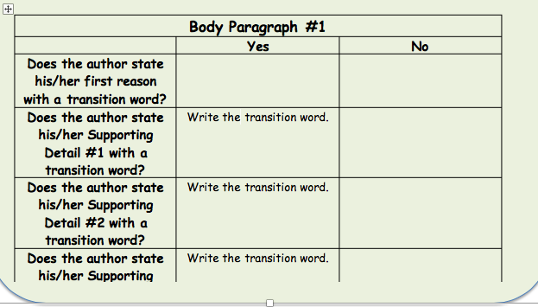
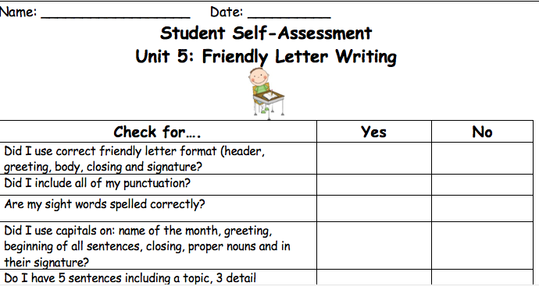
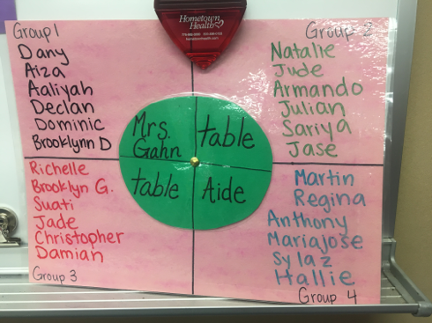
Some example prototypes
A student self-assessment
A rubric for evaluating student work
A classroom chart to assign groups
Notes:
Tell participants that a practice guide or other source of evidence-based practices might suggest one of these change ideas and perhaps even the critical components that might be needed. Educators still need to go through a protyping process to see if the change idea addresses their problem and, if so, for whom the change idea works and under what conditions.

Slide 31
Examples of teacher practice prototypes
Home–school communication journals.
Agenda template for weekly team meetings.
Checklist to monitor planning process.
Morning meeting routine.
Peer-to-peer discussion protocols.
An instructional practice from research or a practice guide.
Transition time routine.

Slide 32
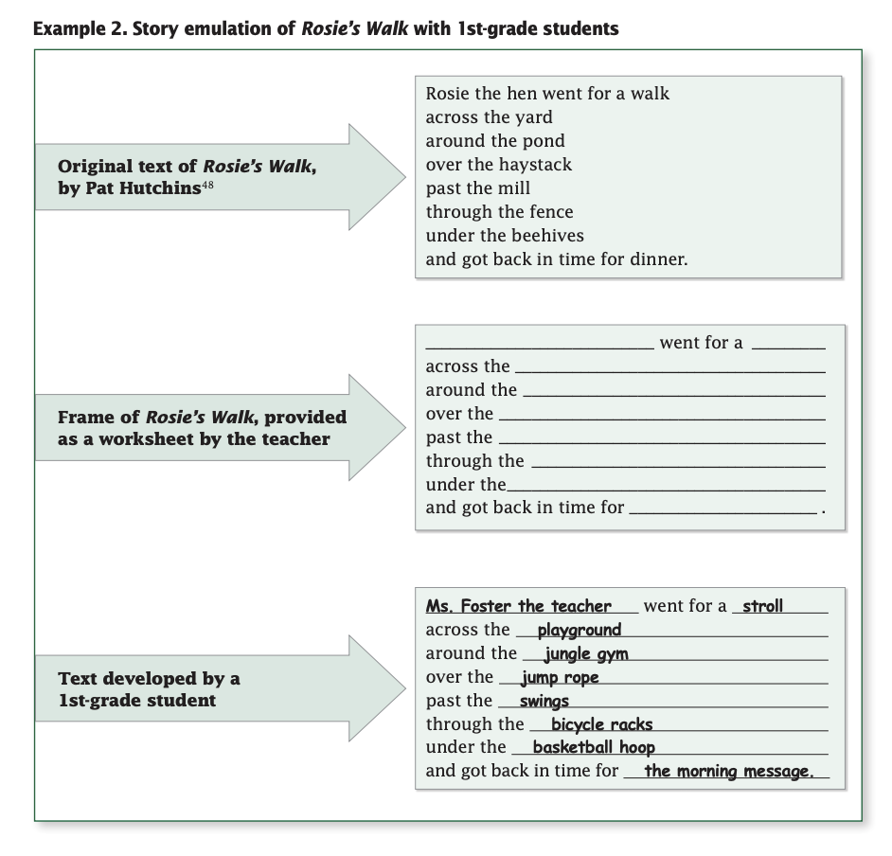
Instructional practice example
This is an example from the What Works Clearinghouse practice guide Teaching elementary school students to be effective writers.
Teachers can adapt existing evidence-based practice examples as prototypes.
Source: Graham et al. (2012).

Slide 33
Developing a prototype
Your team can work together to come up with initial prototypes. These are some development processes:
Create a storyboard.
Create a mood or vision board.
Draw a diagram.
Mock up a document.
Lay out your idea with sticky notes.
Sketch it.
Source: Adapted from Bowman, Dolle, & Takahashi (2019).
Notes:
A storyboard is literally a sketch of what you want to happen in an interaction; this can later be developed into steps in a process. Mood or vision boards focus on the outcomes or experiences you want to create and support the team to map backward to a solution. The important thing is to choose a process that inspires your team to generate ideas.

Slide 34
Prototype simulation
In small groups, develop a prototype for one of the following change ideas:
A discussion protocol for students to use with one another.
A student self-assessment routine.
A peer collaboration routine.
A class meeting routine.
A class transition routine.
A feedback routine for lesson planning with a team.
An idea generated by your small group.
Note: The change idea does not need to be perfect. You may use any prior knowledge or access the internet or evidence-based practice guides to support your work.
Whole-group share-out.
Notes:
Remind participants as they design their prototype to keep these criteria in mind:
A prototype is something created from your identified change idea that is testable, revisable, and shareable.
It helps teammates be clear on what exactly they are testing.
It can be an adaptation from an existing resource, or something newly created for the situation.
In the share-out, ask each group what it is they imagine they are testing in their prototype. For example, the Lemmon Valley team was using a conference tracker, their change idea, to see how frequently they met with students as a first step.

Slide 35
Next steps

Slide 36
Module review
During this module, our learning targets were to …
Understand the difference between a change idea and a prototype.
Understand some guidelines for selecting a change idea.
Selecting a change idea.
Understand what evidence-based practices are.
Using evidence-based practice.
Practice developing a prototype.
Prototyping.
Notes:
As you review the module content, mention some of the key points.
Key points:
• Change ideas are broad concepts, and prototypes are the tangible activities to implement change ideas.
• Teams should seek change ideas that have high impact with a low or reasonable amount of effort. The change should lead to improvement for every student, not just some students (equity pause).
• Care must be taken to be sure that underlying negative assumptions or unproductive discourse does not drive the selection of a change idea or inform the development of a prototype.
• Starting with research or an evidence-based practice or protocol as a change idea is a good way to keep a team focused on objectively addressing the problem.

Slide 37
Action period work
Plan and facilitate team meeting to …
Review evidence-based practices.
Choose a change idea.
Develop a prototype.
Remember to include time for an equity pause to discuss assumptions around effort and impact.
Use the meeting success criteria to monitor team dynamics.
Anticipate places where you may encounter and need to shift unproductive discourse.
Notes:
Review the action period activities with the group and make sure to answer any questions.

Slide 38
Closing reflection
Please share:
What are you thinking about focusing on next to continue this work?
Notes:
Have people share aloud during in-person settings or in the chat for online participation.
This is also an opportunity to include a feedback survey.

Slide 39
References
Anaissie, T., Cary, V., Clifford, D., Malarkey, T., & Wise, S. (2021, June 7). Creative Commons Equity-centered design framework. Stanford d.school. Retrieved December 17, 2021, from https://dschool.stanford.edu/resources/equity-centered-design-framework
Barth, R. (2002). The culture builder. Educational Leadership, 59(8), 6–11. Retrieved December 28, 2021, from https://www.ascd.org/el/articles/the-culture-builder
Bay Area Coalition for Equitable Schools (BayCES). (2004). A guide to data-based inquiry: Using the cycle to drive learning and change for equity. BayCES, Oakland, CA.
Boston Consulting Group (2014). Teachers know best: Teachers’ views on professional development. Seattle, WA: Bill and Melinda Gates Foundation.
Both, T., & Baggereor, D. (2020, April 30). Design thinking bootcamp bootleg. Stanford, CA: Stanford d.school. https://dschool.stanford.edu/resources/the-bootcamp-bootleg
Bowman, A. (2011). Sphere of success [Activity]. National Equity Project, Oakland, CA.
Bowman, A. (2012). Things people say [Activity]. Alliance Learning Solutions.
Bowman, A., Dolle, J., & Takahashi, S. (2019). Improvement Science Institute [Presentation]. San Francisco, CA: WestEd.
Bryk, A., Gomez, L. M., Grunow, A., & LeMahieu, P. G. (2015). Learning to improve: How America’s schools can get better at getting better. Cambridge, MA: Harvard Education Press.
Bryk, A., Sebring, P. B., Allensworth, E., Luppescu, S., & Easton, J. Q. (2010). Organizing schools for improvement: Lessons from Chicago. Chicago, IL: University of Chicago Press.
Carnegie Foundation for the Advancement of Teaching, https://www.carnegiefoundation.org, retrieved April 22, 2021.
Center on School Turnaround. (2017). Four domains for rapid school improvement: A systems framework. San Francisco, CA: The Center for School Turnaround at WestEd.
Council of Chief State School Officers. (2013, April). InTASC Model Core Teaching Standards and Learning Progressions for Teachers 1.0: A resource for ongoing teacher development. Washington, DC: CCSSO.
Cristol, K., & Ramsey, B. S. (2014). Common Core in the districts: An early look at early implementers. Washington, DC: Thomas Fordham Institute.

Slide 40
References
Dana, N. F. (2014). The reflective educator's guide to classroom research: Learning to teach and teaching to learn through practitioner inquiry. Thousand Oaks, CA: Corwin Press.
Dechurch, L., Mesmer-Magnus, J., & Doty, D. (2013). Moving beyond relationship and task conflict: Toward a process-state perspective. Journal of Applied Psychology, 98(4), 559–578. https://doi.org/10.1037/a0032896
Desimone, L., Smith, T. M., & Ueno, K. (2006, April). Are teachers who need sustained, content-focused professional development getting it? An administrator’s dilemma. Educational Administration Quarterly, 42(2), 179–215.
Desimone, L. M. (2009, April 1). Improving impact studies of teachers’ professional development: Toward better conceptualizations and measures. Educational Researcher, 38(3), 181–199. https://journals.sagepub.com/stoken/rbtfl/hYeKyHG/tlbNA/full
Ermeling, B. A. (2009, February 2). Tracing the effects of teacher inquiry on classroom practice. Teaching and Teacher Education, 26(3), 377–388. https://doi.org/10.1016/j.tate.2009.02.019
Fong, P. (2020, December). Now is the time for teachers to use data-based inquiry cycles. Insights & Impact. REL West at WestEd. Retrieved December 28, 2021, from https://www.wested.org/wested-insights/rel-west-data-based-inquiry-cycles/#.
Graham, S., Bollinger, A., Booth Olson, C., D’Aoust, C., MacArthur, C., McCutchen, D., & Olinghouse, N. (2012). Teaching elementary school students to be effective writers: A practice guide (NCEE 2012- 4058). Washington, DC: National Center for Education Evaluation and Regional Assistance, Institute of Education Sciences, U.S. Department of Education. Retrieved from http://ies.ed.gov/ncee/ wwc/publications_reviews.aspx#pubsearch.
Grossman, P., Loeb, S., Cohen, J., Hammerness, K., Wyckoff, J., Boyd, D., et al. (2010). Measure for measure: The relationship between measures of instructional practice in middle school English language arts and teachers’ value-added scores. Cambridge, MA: National Bureau of Economic Research.
Gunrow, A, & Park, S. (2017). Creative Commons Improvement Science Coaching [Presentation]. Licensed by C.C. BY-NC-SA.
Gürdür, D., & Törngren, M. (2018). Visual analytics for cyber-physical systems development: Blending design thinking and systems thinking. Stockholm, Sweden: NordDesign, Department of Machine Design, KTH Royal Institute of Technology.
Hamilton, L., Halverson, R., Jackson, S., Mandinach, E., Supovitz, J., & Wayman, J. (2009). Using student achievement data to support instructional decision making (NCEE 2009-4067). Washington, DC: National Center for Education Evaluation and Regional Assistance, Institute of Education Sciences, U.S. Department of Education. Retrieved from https://ies.ed.gov/ncee/wwc/PracticeGuide/12
Heckman, J. (2017, February 6). The Achievement Gap starts at birth. The Heckman Equation. Retrieved September 15, 2021, from https://heckmanequation.org/resource/starts-at-birth/

Slide 41
References
Hough, H. J., Kerbow, D., Bryk, A., Pinnell, G. S., Rodgers, E., Dexter, E., et al. (2012). Assessing teacher practice and development: The case of comprehensive literacy instruction. School Effectiveness and School Improvement: An International Journal of Research, Policy and Practice 24(4). https://doi.org/10.1080/09243453.2012.731004
Hough, H., Willis, J., Gunrow, A., Krausen, K.., Kwon, S., et al. (2017, November). Continuous improvement in practice. Policy Analysis for California Education. https://www.edpolicyinca.org/publications/continuous-improvement-practice
Kana, J., Kramer, M., & Senge, P. (2021, July 8). The water of systems change. FSG. Retrieved December 17, 2021, from https://www.fsg.org/publications/water_of_systems_change
Kegan, R., & Lahey, L. L. (2001). How the way we talk can change the way we work: Seven languages for transformation. San Francisco, CA: Jossey-Bass.
Langley, G. J., Moen, R., Nolan, K. M., Nolan, T. W., Norman, C. L., & Provost, L. P. (2009). The Improvement Guide. John Wiley & Sons.
Lipton, L., & Wellman, B. M. (2012). Got data? Now what?: Creating and leading cultures of inquiry. Bloomington, IN: Solution Tree Press.
National Equity Project, https://www.nationalequityproject.org/, retrieved December 20, 2020.
Read, J. D. (1983). Detection of Fs in a single statement: The role of phonetic recoding. Memory & Cognition, 11(4), 390–399. https://doi.org/10.3758/bf03202454
Tuckman, Bruce W. (1965). Developmental sequence in small groups. Psychological Bulletin, 63, 384–399.
Valdez, A., Takahashi, S., Krausen, K., Bowman, A., & Gurrola, E. (2020). Getting better at getting more equitable: Opportunities and barriers for using continuous improvement to advance educational equity. San Francisco, CA: WestEd.
Weisberg, A. (2019, January 29). How to conduct needs assessment part 1: What is it and why do it? NC State Industry Expansion Solutions. Retrieved December 17, 2021, from https://www.ies.ncsu.edu/blog/how-to-conduct-needs-assessment-part-1-what-is-it-and-why-do-it/

