Slide 1
Facilitating Improvement in Teacher Practice
Learning Module 5
Root Cause Analysis and Challenging Assumptions

Slide 2
Acknowledgments
This module series includes work that has been adapted from successful strategies developed by Alicia Bowman and Kim Austin for the Regional Educational Laboratory West (REL West) at WestEd.
We would like to acknowledge the Center for the Collaborative Classroom and Washoe County School District for their partnership in this work. We would also like to acknowledge the Carnegie Foundation for the Advancement of Teaching for its contributions to the field that are cited in this work.
Citation: Bowman, A., & Austin, K. (2021). Facilitating Improvement Professional Learning Modules—Module 5: Root cause analysis and challenging assumptions [Slide deck]. Washington, DC: U.S. Department of Education, Institute of Education Sciences, National Center for Education Evaluation and Regional Assistance, Regional Educational Laboratory West.
This product was funded under Contract ED-IES-17-C-0012 by Regional Educational Laboratory West administered by WestEd. The content of this product does not necessarily reflect the views or policies of the Institute of Education Sciences or the U.S. Department of Education, nor does mention of trade names, commercial products, or organizations imply endorsement by the U.S. government.

Slide 3
Welcome
Notes:
We recommend that you include a slide to introduce the facilitation team. This is also where you can build in an opportunity for participant introductions.

Slide 4
Community agreements
(Developed by the cohort in Module 1)
Notes:
Review the community agreements that you developed together during Module 1.
Ask participants to identify an agreement for themselves that they would like to focus on for the day. They do not need to share what they selected.

Slide 5
Progress check-in
Introductions (name/role, if needed).
(2 minutes) Round-robin check-in:
In one word, how are you feeling today?
(8 minutes) Progress checks:
Since our last session, what have you been working on?
Has anything changed that impacts your work?
How is the group dynamic of your team (meeting success criteria)?
Closing.
Notes:
In small groups, ask each table to have a progress check-in.

Slide 6
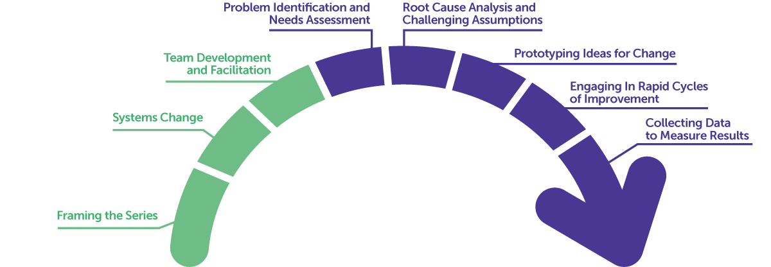
Learning arc for modules
Notes:
Remind participants that in the last session we focused on identifying needs and the specific problem we wanted to solve—the first two improvement questions. Now we will focus on better understanding the root cause of the problem.

Slide 7
Improvement questions
We have four key improvement questions to improve our work:
1. What are our priority needs?
2. What is the problem we are trying to solve?
3. What might we change or introduce, and why?
4. How will we test and build confidence in our changes?
Source: Adapted from Langley (2009).

Slide 8
Learning targets
Understand the importance of finding the root cause.
Explore some methods for root cause analysis.
Understand the importance of challenging assumptions.
Notes:
As you describe the learning targets, mention some of the key points.
Key points:
· Finding the root cause of a problem allows for a problem to be eliminated, rather than just the symptoms.
· There is no single correct way to find the root cause of a problem
· Surfacing mental models allows teams to go beyond their assumptions and past experiences.
· Unproductive discourse may signal shifts in conditions or mindsets that are needed for improvement efforts to be successful.

Slide 9
Topics
What is a root cause analysis?
Finding a root cause.
Making mental models visible.

Slide 10
What is a root cause analysis?

Slide 11
Self-reflection
What is causing the problem we are trying to solve?
Have you ever had a problem that kept coming back no matter how many times you tried to solve it, and then someone who knew more about the type of problem fixed it almost instantly?
Notes:
Provide a few minutes for individual reflection in the participant workbook, and then ask if anyone would like to share their response with the group. Take two to three responses and move on.
Be prepared to give an example for the second question if participants don’t have one.

Slide 12
“Every system is perfectly designed to get the results it gets.”
̶ Dr. Paul Batalden
Notes:
Remind participants that in Module 2, we said a system is more than a sum of its parts. It is the complex interrelationships between the parts that make a system work; some of these are above the surface, and some are below. If you take the time to understand the system in which a problem is operating, you can change the outcome. We’ll learn how to find the root cause of a problem to think about what we need to change and why.

Slide 13
What is a root cause?
Before you can solve a problem, you need to have at least a general idea of what caused it.
A root cause analysis is a structured team process that assists in identifying underlying factors or causes of identified problems.

Slide 14
What is a root cause?
Developed by the National Aeronautics and Space Administration (NASA) in the 1950s, root cause analysis has been applied to methodically identify and correct the underlying systemic causes of events, rather than to simply address the symptomatic results.
Focusing on root causes has the goal of entirely preventing a problem from recurring.
Notes:
Emphasize the last paragraph. Focusing on the root cause is about preventing the problem from recurring. As when you are pulling weeds from a garden, if you miss the roots, the weed will grow back.

Slide 15
What is a root cause?
Root cause analysis is an iterative process that takes place throughout a continuous improvement journey.
An identified root cause is essentially a well-informed working hypothesis.
As you test your hypothesis and learn more about your system, you may need to adjust your root cause and/or the actions or methods you are using to address your problem.
Notes:
Share that you may not immediately identify the root cause correctly; but using the scientific method, you get as close as possible and then test your methods to prove or disprove your hypothesis.

Slide 16
Finding a root cause

Slide 17
An improvement story: Lemmon Valley 3rd grade team
Continuing our story of the 3rd grade team ...
The teachers asked themselves why they were not reaching all their students for writing conferences as frequently as they wanted to.
After examining possible causes, the teachers agreed that the root cause of this problem was that it was difficult to keep track of whom they were supporting and when.

Slide 18
Self-reflection
What methods have you used in the past to determine the root cause of a problem?
Notes:
Provide a few minutes for individual reflection in the workbook, and then ask if anyone would like to share their response with the group. Take two to three responses and move on.

Slide 19
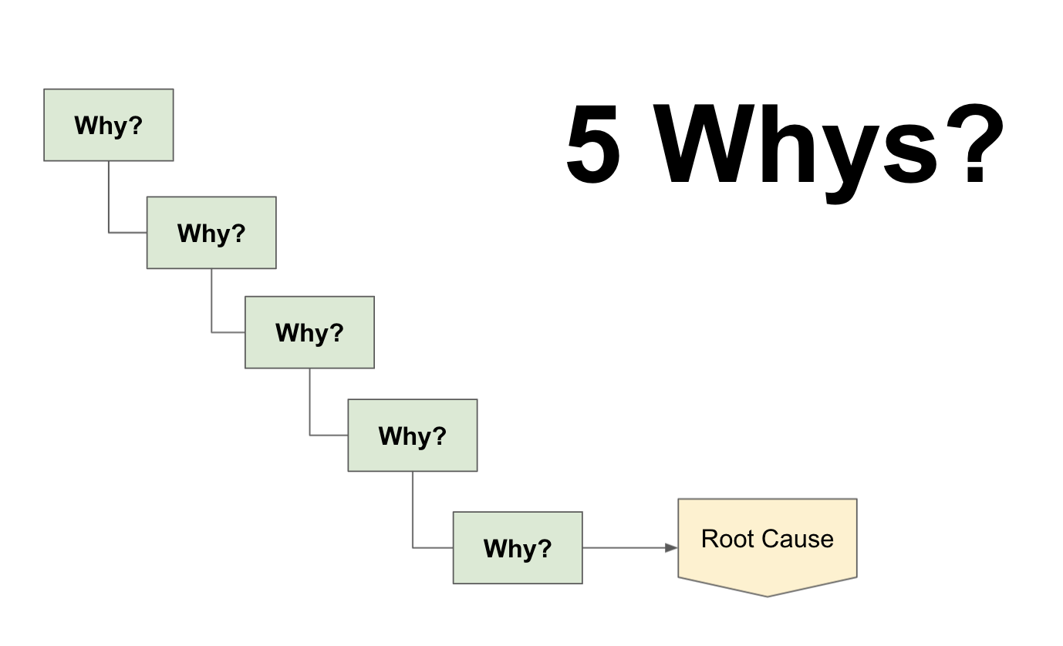
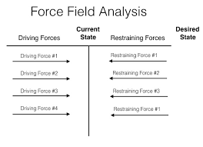
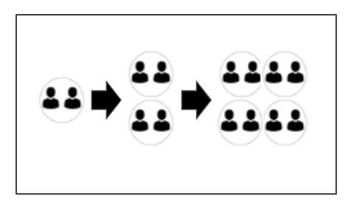
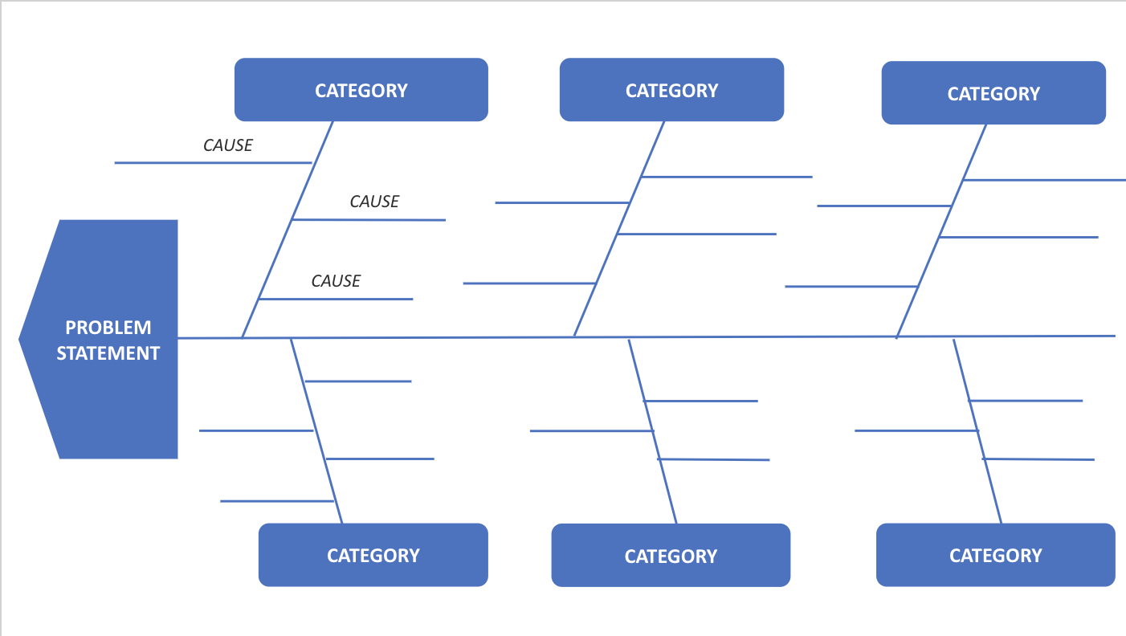
Four methods for root cause analysis
Please share any of these methods that are familiar to you or that you have used before.
5 Whys?
Force Field Analysis
Snowballing
Fishbone Diagram
Notes:
Suggest that as you describe each method of conducting a root cause analysis, participants follow along in their workbooks and highlight or make notes about how they might use these strategies to identify the root cause of their identified need or problem.
Tell participants the full instructions for each root cause analysis process are in the appendix at the end of the workbook.

Slide 20
5 Whys? root cause analysis
The 5 Whys? root cause analysis is a group brainstorming process.
It works well if you are working with a larger team or group of stakeholders.
In smaller groups, it is sometimes more difficult to come up with a large number of responses to consider.

Slide 21
5 Whys? root cause analysis
Steps for using the 5 Whys? process:
Ask the question, “Why is this problem happening?” and brainstorm responses.
Go through the list and eliminate any responses that are assumptions.
As a team, select a response from those that remain that you agree is a primary cause for the problem.
Repeat this questioning process up to five times, or until you are unable to generate responses.
Look at each response that you selected and decide whether each response is a concern or an area you can control. (“Concern” refers to a contributing factor that is not within your team’s ability to directly change. “Control” refers to contributing factors that are within your locus of control.)

Slide 22
Force Field Analysis
This protocol is intended to help you better understand the forces that support and hinder your improvement efforts.
This process can be used to focus a system investigation or as a root cause analysis tool. It can easily be used with a group of 2–8 people.
It is most effective with groups that know the context well and can speak to the supporting forces (assets that are available) and the restraining forces (barriers to improvement).

Slide 23
Force Field Analysis
Steps for the Force Field Analysis:
Individual brainstorm of supporting and restraining forces.
Group share and clustering of supporting forces.
Group share and clustering of restraining forces.
Review the restraining forces and identify those that are within your locus of control. Review the supporting forces for possible levers your team may use to address the restraining forces.

Slide 24
Snowballing
This method supports individual thinking and group collaboration by supporting a group through a repetitive brainstorming and refining process leading to group consensus.
Pairs brainstorm possible root causes and then share their best thinking with another pair. This group then shares their best combined thinking in a larger group.
Snowballing is best used with small to medium groups (4–8 participants).

Slide 25
Snowballing
Steps for the Snowballing process:
Individual brainstorm.
Pair share.
Quad share.
Whole group share.

Slide 26
Fishbone Diagram
A Fishbone Diagram …
Can be used for a variety of purposes.
Can identify underlying factors or causes of a problem.
Is a way to produce a visual representation of potential cause-and-effect relationships.
Can be helpful by directing the team to surface categories that might not otherwise be considered and to think of additional possible causes in each category.
Note: Participants should include individuals who have personal knowledge of the problem from multiple perspectives.

Slide 27
Fishbone Diagram
Steps for the Fishbone Diagram:
Individual brainstorm.
Cluster and create categories.
Review for symptoms and assumptions.
Fill out the diagram.
Prioritize categories and possible causes.

Slide 28
Root cause analysis
All four of these processes play a similar role of identifying underlying factors or possible causes of identified problems.
You will need to work with your team to identify a process that will work best for you.

Slide 29
Pair share
Review the protocols.
Which root cause analysis process would work best for your team, and why?
Notes:
Provide 5 minutes for pairs to review the four methods and reflect with each other. When you return to the whole group, ask if anyone would like to share their choice and reason for the choice with the group. Take two to three responses. Reiterate why that method is well-suited to the participant’s context.

Slide 30
Making mental models visible

Slide 31
“If we worked on the assumption that what is accepted as true really is true, then there
would be little hope for advance.”
̶ Orville Wright

Slide 32
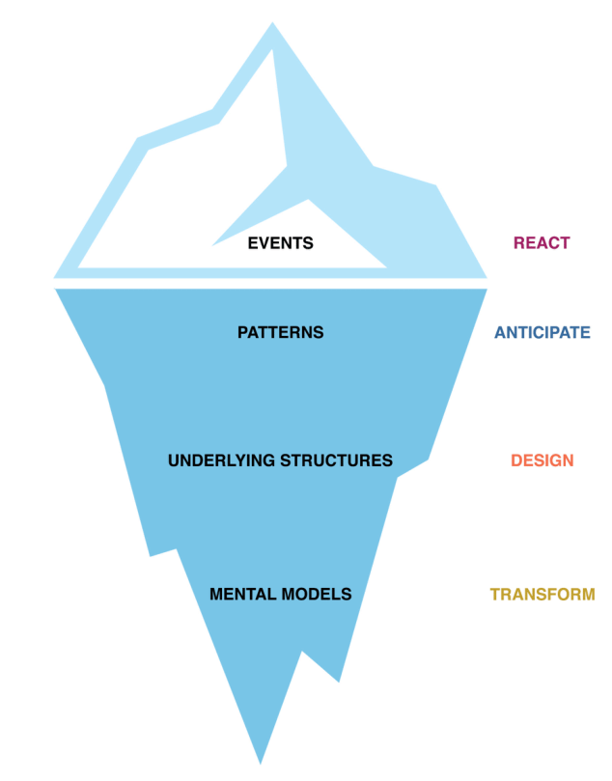
Surfacing mental models
Understanding the underlying factors of systems-related issues creates opportunities to change the system.
Mental models are at the “transform” level and are furthest under the surface.
Although mental models are the least visible, change at this level is the most transformative.

Slide 33
Surfacing mental models
Mental models are made up of a series of underlying assumptions.
Mental models are invisible. They show up only through our actions and our words.

Slide 34
Surfacing mental models
How we define the problem will shape the solutions we develop.
“For instance, defining the problem as about coherence (e.g., teachers not teaching consistent writing skills across grades or classes) would likely lead to solutions focused on alignment and consistency. Whereas defining the problem as too little teaching of writing because of lack of teachers’ knowledge of writing instruction would tend to lead to solutions involving teacher professional development in writing instruction.”
—Bay Area Coalition for Equitable Schools (2004)

Slide 35
Surfacing mental models
Harvard researchers Kegan and Lahey (2001) have found that what we say and how we say it surfaces some of the mental models that are driving us.
Their research supports the idea that to create change in our organizations, we must first look at what we do and say that is keeping us from realizing the changes we desire.
Notes:
Remind participants that we talked about productive and unproductive discourse in Module 3 when we talked about teams. Explain that key to changing systems is to use language that challenges assumptions and transforms the mental models team members may hold.
Suggest participants highlight key phrases or take notes in their participant workbook.

Slide 36
From complaint to commitment
Language of complaint (unproductive) | Language of commitment (productive)
Expresses what we cannot do. | Expresses what we aspire to or stand for.
Sounds negative or cynical. | Communicates conviction or possibility.
Frustrates individuals or shuts down the conversation. | Inspires and brings energy to the conversation.
Nontransformational: lets off steam but does not help move toward solutions. | Transformational: builds a foundation for purpose-driven work.
Source: Adapted from Kegan & Lahey (2001).
Notes:
Be prepared to give examples or solicit examples that compare these types of discourse as you introduce them.

Slide 37
From blame to personal responsibility
Language of blame (unproductive) | Language of personal responsibility (productive)
Holds other people responsible for gaps between intentions and reality. | Generates productive conversations that lead to problem-solving.
Built on generalizations and alienation of others. | Draws on our commitments and encourages collaboration.
Discourages exploration. | Raises questions to be answered.
Nontransformational: deflects attention to outside of the locus of control. | Transformational: directs attention to where we have the most influence.
Source: Adapted from Kegan & Lahey (2001).
Notes:
Be prepared to give examples or solicit examples that compare these types of discourse as you introduce them.

Slide 38
From assumptions to an inquiry stance
Language of assumptions (unproductive) | An inquiry stance (productive)
Voices ingrained mental models. | Examines data and evidence.
Makes unsubstantiated judgments. | Asks questions.
Includes broad generalizations. | Looks at multiple perspectives.
Nontransformational: reframes problems based on past experiences instead of reality. | Transformational: gets to the root causes of problems using evidence.
Source: Adapted from Kegan & Lahey (2001).
Notes:
Be prepared to give examples or solicit examples that compare these types of discourse as you introduce them.

Slide 39
Unproductive discourse can show up in both formal and informal spaces ...
Discussing students during lunch.
Conducting data conversations about achievement gaps.
Having conversations about attendance and motivation.
Determining who is responsible for a particular intervention.
Discontinuing an ineffective process.
Introducing a new process.
Notes:
Be prepared to give examples or solicit examples of these types of discourse.

Slide 40
Self-reflection
When and where have you heard the languages of complaint, blame, and assumptions?
Are there recurring topics that produce this discourse?
Notes:
Provide a few minutes for individual reflection in the participant notebook and then ask if anyone would like to share their response with the group. Take two to three responses and move on.

Slide 41
Shifting unproductive discourse
Four steps to shift discourse:
Acknowledge—validate the individual’s experience.
Listen—ask for and listen to the individual’s perspective.
Reflect—share back a summary of what you heard.
Reframe—ask the individual for alternatives (or possibly provide a suggestion from your experience).
Notes:
As you present each step, ask participants for examples for each. Be prepared to supply your own examples as well.

Slide 42
Practice shifting discourse
In trios:
Use the provided scenario to role-play a conversation and shift the discourse.
Roles—speaker, coach, observer.
As you prepare to role-play, consider the following:
What is the problem, and why is it a problem?
Why might this be a difficult conversation?
What is your emotional investment, and what might trigger you?
What is your goal or desired outcome for the conversation?
Notes:
Provide at least 10 minutes for trios to review the scenario and practice the conversation once. Add an additional 10 minutes and ask participants to switch roles and repeat the conversation with a different approach.
Ask participants what was challenging about this activity. Was there a strategy that worked well to shift the discourse?

Slide 43
Discourse role-play scenario
One of this year’s goals is to reduce the number of student referrals. All teachers went through training at the beginning of the year, and you were feeling optimistic. Looking at your school referral data, you see that the numbers overall are going down, but 80 percent of your grade 5 referrals are coming from Teacher A’s classroom; Teacher A’s numbers have not decreased.
You shared the data with the grade 5 team during their next collaboration meeting, and Teacher A had a strong reaction. During the meeting, she blamed the referrals on having a “wild class this year” and took no responsibility for the continued referrals. You were able to move the overall conversation in a productive direction, but you still need to address Teacher A.

Slide 44
Equity pause: Revisit your root cause analysis
EQUITY
PAUSE
Take a moment to consider the thoughts and feelings that emerged for you as you engaged in the role-play activity.
Did you experience any discomfort?
How could you apply this practice when deficit thinking or blaming comes up in discussions?
Notes:
This equity pause can be a small-group or whole-group discussion, depending on the size of your group. It is important that the discussion groups are small enough for everyone to be able to participate.

Slide 45
“The ultimate measure of a man is not where he stands in the moments of comfort and convenience, but where he stands in times of challenge and controversy.”
̶ Martin Luther King Jr.

Slide 46
Next steps

Slide 47
Module review
During this module our learning targets were to …
Understand the importance of finding the root cause.
What is a root cause analysis?
Explore some methods for root cause analysis.
Identify a root cause.
Understand the importance of challenging assumptions.
Make mental models visible.
Notes:
As you review the module content, mention some of the key points.
Key points:
· Finding the root cause of a problem allows for a problem to be eliminated, rather than just the symptoms.
· There is no single correct way to find the root cause of a problem
· Surfacing mental models allows teams to go beyond their assumptions and past experiences.
· Unproductive discourse may signal shifts in conditions or mindsets that are needed for improvement efforts to be successful.

Slide 48
Action period work
Select a root cause analysis process to use with your team.
Plan a team huddle:
Review your team’s agreed-upon problem.
Use a root cause analysis tool to focus your problem.
Include an equity pause to check for assumptions and locus of control.
Use the meeting success criteria to monitor team dynamics.
Anticipate places where you may encounter and need to shift unproductive discourse.
Optional: role-play shifting discourse with a colleague.
Notes:
Review the action period activities with the group and make sure to answer any questions.
You may be able to include extra team time to begin the action period work. This module is slightly shorter than some of the others.

Slide 49
Closing reflection
Please share:
What is something you will specifically attend to as you identify a root cause for your problem?
Notes:
Have people share aloud during in-person settings or in the chat for online participation.
This is also an opportunity to include a feedback survey.

Slide 50
References
Anaissie, T., Cary, V., Clifford, D., Malarkey, T., & Wise, S. (2021, June 7). Creative Commons Equity-centered design framework. Stanford d.school. Retrieved December 17, 2021, from https://dschool.stanford.edu/resources/equity-centered-design-framework
Barth, R. (2002). The culture builder. Educational Leadership, 59(8), 6–11. Retrieved December 28, 2021, from https://www.ascd.org/el/articles/the-culture-builder
Bay Area Coalition for Equitable Schools (BayCES). (2004). A guide to data-based inquiry: Using the cycle to drive learning and change for equity. BayCES, Oakland, CA.
Boston Consulting Group (2014). Teachers know best: Teachers’ views on professional development. Seattle, WA: Bill and Melinda Gates Foundation.
Both, T., & Baggereor, D. (2020, April 30). Design thinking bootcamp bootleg. Stanford, CA: Stanford d.school. https://dschool.stanford.edu/resources/the-bootcamp-bootleg
Bowman, A. (2011). Sphere of success [Activity]. National Equity Project, Oakland, CA.
Bowman, A. (2012). Things people say [Activity]. Alliance Learning Solutions.
Bowman, A., Dolle, J., & Takahashi, S. (2019). Improvement Science Institute [Presentation]. San Francisco, CA: WestEd.
Bryk, A., Gomez, L. M., Grunow, A., & LeMahieu, P. G. (2015). Learning to improve: How America’s schools can get better at getting better. Cambridge, MA: Harvard Education Press.
Bryk, A., Sebring, P. B., Allensworth, E., Luppescu, S., & Easton, J. Q. (2010). Organizing schools for improvement: Lessons from Chicago. Chicago, IL: University of Chicago Press.
Carnegie Foundation for the Advancement of Teaching, https://www.carnegiefoundation.org, retrieved April 22, 2021.
Center on School Turnaround. (2017). Four domains for rapid school improvement: A systems framework. San Francisco, CA: The Center for School Turnaround at WestEd.
Council of Chief State School Officers. (2013, April). InTASC Model Core Teaching Standards and Learning Progressions for Teachers 1.0: A resource for ongoing teacher development. Washington, DC: CCSSO.
Cristol, K., & Ramsey, B. S. (2014). Common Core in the districts: An early look at early implementers. Washington, DC: Thomas Fordham Institute.

Slide 51
References
Dana, N. F. (2014). The reflective educator's guide to classroom research: Learning to teach and teaching to learn through practitioner inquiry. Thousand Oaks, CA: Corwin Press.
Dechurch, L., Mesmer-Magnus, J., & Doty, D. (2013). Moving beyond relationship and task conflict: Toward a process-state perspective. Journal of Applied Psychology, 98(4), 559–578. https://doi.org/10.1037/a0032896
Desimone, L., Smith, T. M., & Ueno, K. (2006, April). Are teachers who need sustained, content-focused professional development getting it? An administrator’s dilemma. Educational Administration Quarterly, 42(2), 179–215.
Desimone, L. M. (2009, April 1). Improving impact studies of teachers’ professional development: Toward better conceptualizations and measures. Educational Researcher, 38(3), 181–199. https://journals.sagepub.com/stoken/rbtfl/hYeKyHG/tlbNA/full
Ermeling, B. A. (2009, February 2). Tracing the effects of teacher inquiry on classroom practice. Teaching and Teacher Education, 26(3), 377–388. https://doi.org/10.1016/j.tate.2009.02.019
Fong, P. (2020, December). Now is the time for teachers to use data-based inquiry cycles. Insights & Impact. REL West at WestEd. Retrieved December 28, 2021, from https://www.wested.org/wested-insights/rel-west-data-based-inquiry-cycles/#.
Graham, S., Bollinger, A., Booth Olson, C., D’Aoust, C., MacArthur, C., McCutchen, D., & Olinghouse, N. (2012). Teaching elementary school students to be effective writers: A practice guide (NCEE 2012- 4058). Washington, DC: National Center for Education Evaluation and Regional Assistance, Institute of Education Sciences, U.S. Department of Education. Retrieved from http://ies.ed.gov/ncee/ wwc/publications_reviews.aspx#pubsearch.
Grossman, P., Loeb, S., Cohen, J., Hammerness, K., Wyckoff, J., Boyd, D., et al. (2010). Measure for measure: The relationship between measures of instructional practice in middle school English language arts and teachers’ value-added scores. Cambridge, MA: National Bureau of Economic Research.
Gunrow, A, & Park, S. (2017). Creative Commons Improvement Science Coaching [Presentation]. Licensed by C.C. BY-NC-SA.
Gürdür, D., & Törngren, M. (2018). Visual analytics for cyber-physical systems development: Blending design thinking and systems thinking. Stockholm, Sweden: NordDesign, Department of Machine Design, KTH Royal Institute of Technology.
Hamilton, L., Halverson, R., Jackson, S., Mandinach, E., Supovitz, J., & Wayman, J. (2009). Using student achievement data to support instructional decision making (NCEE 2009-4067). Washington, DC: National Center for Education Evaluation and Regional Assistance, Institute of Education Sciences, U.S. Department of Education. Retrieved from https://ies.ed.gov/ncee/wwc/PracticeGuide/12
Heckman, J. (2017, February 6). The Achievement Gap starts at birth. The Heckman Equation. Retrieved September 15, 2021, from https://heckmanequation.org/resource/starts-at-birth/

Slide 52
References
Hough, H. J., Kerbow, D., Bryk, A., Pinnell, G. S., Rodgers, E., Dexter, E., et al. (2012). Assessing teacher practice and development: The case of comprehensive literacy instruction. School Effectiveness and School Improvement: An International Journal of Research, Policy and Practice 24(4). https://doi.org/10.1080/09243453.2012.731004
Hough, H., Willis, J., Gunrow, A., Krausen, K.., Kwon, S., et al. (2017, November). Continuous improvement in practice. Policy Analysis for California Education. https://www.edpolicyinca.org/publications/continuous-improvement-practice
Kana, J., Kramer, M., & Senge, P. (2021, July 8). The water of systems change. FSG. Retrieved December 17, 2021, from https://www.fsg.org/publications/water_of_systems_change
Kegan, R., & Lahey, L. L. (2001). How the way we talk can change the way we work: Seven languages for transformation. San Francisco, CA: Jossey-Bass.
Langley, G. J., Moen, R., Nolan, K. M., Nolan, T. W., Norman, C. L., & Provost, L. P. (2009). The Improvement Guide. John Wiley & Sons.
Lipton, L., & Wellman, B. M. (2012). Got data? Now what?: Creating and leading cultures of inquiry. Bloomington, IN: Solution Tree Press.
National Equity Project, https://www.nationalequityproject.org/, retrieved December 20, 2020.
Read, J. D. (1983). Detection of Fs in a single statement: The role of phonetic recoding. Memory & Cognition, 11(4), 390–399. https://doi.org/10.3758/bf03202454
Tuckman, Bruce W. (1965). Developmental sequence in small groups. Psychological Bulletin, 63, 384–399.
Valdez, A., Takahashi, S., Krausen, K., Bowman, A., & Gurrola, E. (2020). Getting better at getting more equitable: Opportunities and barriers for using continuous improvement to advance educational equity. San Francisco, CA: WestEd.
Weisberg, A. (2019, January 29). How to conduct needs assessment part 1: What is it and why do it? NC State Industry Expansion Solutions. Retrieved December 17, 2021, from https://www.ies.ncsu.edu/blog/how-to-conduct-needs-assessment-part-1-what-is-it-and-why-do-it/

