Slide 1
Facilitating Improvement in Teacher Practice
Learning Module 2
Systems Change

Slide 2
Acknowledgments
This module series includes work that has been adapted from successful strategies developed by Alicia Bowman and Kim Austin for the Regional Educational Laboratory West (REL West) at WestEd.
We would like to acknowledge the Center for the Collaborative Classroom and Washoe County School District for their partnership in this work. We would also like to acknowledge the Carnegie Foundation for the Advancement of Teaching for its contributions to the field that are cited in this work.
Citation: Bowman, A., & Austin, K. (2021). Facilitating Improvement Professional Learning Modules—Module 2: Systems change [Slide deck]. Washington, DC: U.S. Department of Education, Institute of Education Sciences, National Center for Education Evaluation and Regional Assistance, Regional Educational Laboratory West.
This product was funded under Contract ED-IES-17-C-0012 by Regional Educational Laboratory West administered by WestEd. The content of this product does not necessarily reflect the views or policies of the Institute of Education Sciences or the U.S. Department of Education, nor does mention of trade names, commercial products, or organizations imply endorsement by the U.S. government.

Slide 3
Welcome
Notes:
We recommend that you include a slide to introduce the facilitation team. This is also where you can build in an opportunity for participant introductions.

Slide 4
Community agreements
(Developed by the cohort in Module 1)
Notes:
Review the community agreements that you developed together during module 1.
Ask participants to identify an agreement for themselves that they would like to focus on for the day. They do not need to share what they selected. This will help participants become more familiar with the agreements and remain conscious of them during the process. It also models the process they can use with their teams.

Slide 5
Progress check-in
Introductions (name/role, if needed).
(2 minutes) Round-robin check-in:
In one word, how are you feeling today?
(8 minutes) Progress checks:
Since our last session, share your progress on the action period questions.
Closing.
Notes:
In small groups, ask each table to have a progress check-in. Emphasize that you’ll use this check-in process each session. It is designed to introduce a procedure that will become routine over time, much like the meetings or huddles in the improvement process.

Slide 6
Learning arc for modules
Notes:
Explain to participants that this professional learning series is focused on creating change in systems rather than making isolated changes in classrooms or schools. Today we’ll focus on what it means to engage in systems change.

Slide 7
Improvement questions
We have four key improvement questions to improve our work:
1. What is the problem we are trying to solve?
1. What are our priority needs?
2. What is the problem we are trying to solve?
2. What might we change or introduce and why?
3. What might we change or introduce, and why?
3. How will we test and build confidence in our changes?
4. How will we test and build confidence in our changes?
Source: Adapted from Langley (2009).

Slide 8
Learning targets for Module 2
Learn about systems and how you can impact system improvement.
Understand the role of equity in systems improvement work.
Begin to develop a theory of improvement for your work.
Notes:
As you describe the learning targets, mention some of the key points.
Key points:
Complex systems are systems within systems, each of which has the following components: leadership, context, culture, resources, and processes.
Unless we slow down and surface and acknowledge our mental models and the assumptions, beliefs and dispositions that shape them, it will be difficult to identify and solve the right problem.

Slide 9
Module 2 topics
Definition of a system.
Seeing the system.
Surfacing inequities.
How systems improve.
Theory of improvement.

Slide 10
Definition of a system
Notes:
Slides 11–19 provide content to define what we mean by a system in these learning modules. The facilitator can present these slides, or you may use the “systems change” video in place of the slides: Improving School Systems, https://youtu.be/D8rRF7aHl7Y
During this segment, suggest participants highlight or take notes in their participant workbook, as the concepts of understanding and improving systems are fundamental to improvement work.

Slide 11
What is a system?
A system is an interacting or interdependent group of things that form a unified whole.
An organizational system is “characterized by a set of interactions among the people who work there, the tools and materials they have at their disposal, and the processes through which these people and resources join together to accomplish its goals.”
Source: Bryk, Gomez, Grunow, & LeMahieu (2015).
Notes:
Facilitators may want to show this video, which covers much of the content of this section: Improving School Systems, https://youtu.be/D8rRF7aHl7Y

Slide 12
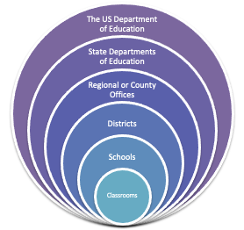
What is a system?
Our public school system exists as systems within systems. This is a complex system.
Notes:
We often think about our education systems as just hierarchical, where change is either top down or bottom up. In fact, our system is composed of multiple systems that interact and impact each other in multiple ways. There is a ripple effect that can come from any place in the larger system. This interactivity makes this a complex system.

Slide 13
What is a system?
School
Complex systems are made up of many parts interacting with one another and their environment in multiple ways.
These parts form networks that constantly interact with one another.
County
County
College
District
State
County
County
County
Federal
Source: Bowman, Dolle, & Takahashi (2019).
Notes:
Explain that complex systems are like fractals. A fractal is a mathematical concept in which a larger part can be broken down into smaller parts which have the same components as its parent. Our public education system is made up of many different systems of different sizes and different regions, but still forming a network across the country. A change in one place in the education system impacts the others in relation to the scale of the other systems.

Slide 14
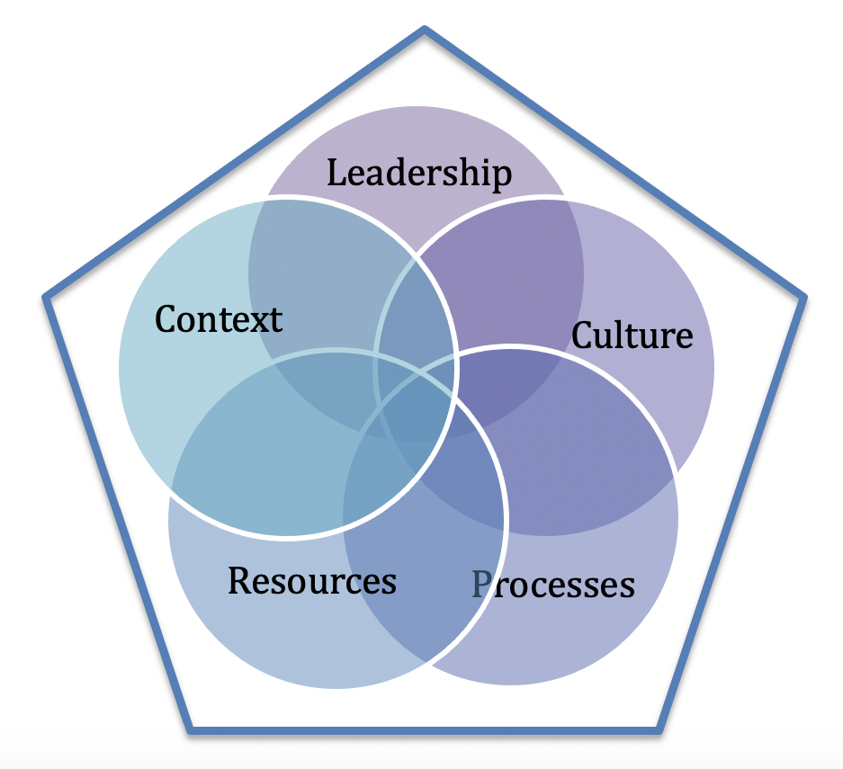
What is a system?
Within each of these layered systems, there are some common interdependent elements:
Leadership.
Context.
Culture.
Resources.
Processes.
Notes:
Explain that within each level of the education system, there are commonalities. These five components are some elements of the fractal that are common across the levels of the system. Tell participants that we will revisit these elements throughout the training series.

Slide 15
Leadership
Leadership, in this system model, refers to the actions of leadership that build and sustain the system.
These include, but are not limited to …
Communicating a clear mission, vision, and goals.
Engaging all stakeholders and leveraging multiple perspectives.
Using data and evidence to drive decisions.
Focusing attention on what is important
Modeling effective practices.
Source: Adapted from Center on School Turnaround (2017).
Notes:
Be prepared with examples of these actions.

Slide 16
Context
Context, in this system model, refers to all of the contributing factors that make a particular system unique.
These include, but are not limited to …
Historical context.
Policy and power structures.
Demographics (such as location, population, existing disparities).
Organizational structures.
Notes:
Be prepared with examples of these contributing factors.

Slide 17
Culture
Culture, in this system model, refers to how people work together and interact with one another, as well as shared beliefs and dispositions.
Components of culture include, but are not limited to …
Shared purpose.
Relational trust.
Collective and self-efficacy.
Collaboration.
Common practices.
Notes:
Be prepared with examples of these beliefs and dispositions, especially how they can operate below the surface of an educational system but influence how the system operates.

Slide 18
Resources
Resources, in this system model, refer to access to the necessary sources of supply and support that enable the system to function.
Resources include, but are not limited to …
People.
Time.
Money.
Materials.
Technology.
Notes:
Ask participants for examples, but be prepared with examples of these sources of supply and support.

Slide 19
Processes
Processes, in this system model, refer to continuous and/or repetitive actions and operations that are used to accomplish work and manage day-to-day activities.
Processes include, but are not limited to …
Planning.
Meeting structures.
Communication methods.
Common routines and practices.
Decisionmaking.
Source: Adapted from Bowman, Dolle, & Takahashi (2019).
Notes:
Be prepared with examples of these processes.

Slide 20
Self-reflection
What did you learn about systems?
What connections can you make to your current work?
What questions do you still have?
Notes:
Provide a few minutes for individual reflection and review of participants’ notes and highlighting in the workbook. Then ask if anyone would like to share their response with the group. Take two to three responses and move on. Especially if the video is used, be sure participants mention the system elements (see slides 11–19) in response to the first question.

Slide 21
Seeing the system

Slide 22
Seeing the system
We all have mental models of how the world works, including how our systems work.
Notes:
Explain to participants that mental models incorporate all the assumptions we hold about how a system works. We need to uncover and unpack the system to better understand the nature of the problem we need to solve.

Slide 23
Seeing the system
“Organisations learn only through individuals who learn. Individual learning does not guarantee organisational learning, but without it no organisational learning occurs.”
̶ Peter Senge The fifth discipline, 1990
How an individual or group interprets and defines a problem determines how they will approach solving it.

Slide 24
Fast thinking
In education, we tend to operate in crisis mode much of the time. We often get through the day by handling routine decisions with gut decisions.
This “fast thinking” is unconscious and is shaped by the mental models created by our experiences and the norms inherent in the systems we operate in. This can shape how we react to and attempt to solve the problems in our system.
When we are unaware of the mental models driving us, we can find ourselves solving the wrong problems.
Notes:
Key to this content is that unless we slow down and surface and acknowledge our mental models and the assumptions, beliefs, and dispositions that shape them, it will be difficult to identify and solve the right problem.

Slide 25
Fast thinking activity
You are now going to see a sentence.
You will have 10 seconds to read it and respond to the prompt.
Notes:
For slides 25–28: You may follow the directions on the slides for this activity or provide the activity phrase on a slip of paper for each participant. Make sure you have a timer or are watching a clock to monitor time. After 10 seconds, advance the slide (or have participants put away their paper).

Slide 26
Fast thinking activity
FINISHED FILES ARE THE RESULT OF YEARS OF SCIENTIFIC STUDY COMBINED WITH THE EXPERIENCE OF YEARS
How many Fs are in the sentence above?
You have 10 seconds to count.
Source: Read (1983).

Slide 27
Fast thinking activity
How many Fs were in the sentence?
Source: Read (1983)

Slide 28
Fast thinking activity
FINISHED FILES ARE THE RESULT OF YEARS OF SCIENTIFIC STUDY COMBINED WITH THE EXPERIENCE OF YEARS
Most people see three Fs and completely miss the Fs in the word “of.” This is one example of how fast thinking helps our brains to take shortcuts.
Source: Read (1983).
Notes:
Reveal the answer: six Fs.
Explain that this “fast thinking” is unconscious and is shaped by the mental models created by our experiences and the norms inherent in the systems we operate in. This can shape how we react to and attempt to solve the problems in our system. When we are unaware of the mental models driving us, we can find ourselves solving the wrong problems.

Slide 29
Self-reflection
How did it feel to do this activity?
Can you think of times when you might default to fast thinking?
Notes:
Invite individuals to reflect on the activity first in their workbook and then with the whole group. Take the time for three to four individuals to share before moving on. In response to the second question, ask if there were assumptions that were used to make decisions. Provide an example of a time fast thinking shaped a decision-making process.

Slide 30
Continuous improvement interrupts fast thinking by intentionally taking us through a process that forces us to slow down and examine what is underneath the surface.
Notes:
As you present slides 30–35 about the iceberg, ask participants to be thinking about the five components of systems (context, leadership, culture, resources, and processes) and how they present at each level.

Slide 31
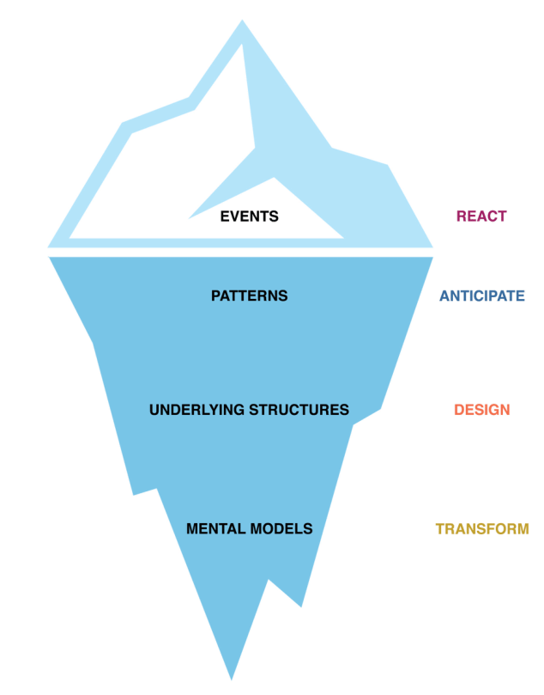
Seeing your system
Seeing your system requires that you look deeper than the events at the surface.
Understanding the underlying factors of systems-related issues creates opportunities to change the system.
Source: Image from Gürdür & Törngren (2018).

Slide 32
Seeing your system
The event level:
Refers to the symptoms of a problem that are easily seen. These are what we generally react to with fast thinking.
The pattern level:
Refers to the patterns of recurring issues over time. This level allows you to use data to identify and anticipate outcomes that you want to interrupt.

Slide 33
Seeing your system
The structures level: Refers to the underlying structures (such as policies, practices, behaviors) in a system. A deeper look at these allows you to identify barriers and design new solutions.
The mental models level: Refers to the attitudes, beliefs, expectations, and values that allow the structures in your system to operate the way they do. Shifting mental models allows for transformation.
Notes:
Mental models are based on experiences and belief systems. Recognizing the role of mental models and how we can default to fast thinking under stress is foundational to recognizing how inequities can be unintentionally perpetuated or replicated in our educational system.

Slide 34
Seeing your system
To see your system, you need to look underneath the surface and understand how your leadership, context, culture, resources, and processes may be at the root of the problem you are trying to solve.

Slide 35
“Systems change is about shifting the conditions that are holding the problem in place.”
̶Kana, Kramer, & Senge (2021)

Slide 36
Self-reflection
What problems has your school or district been grappling with?
What factors at the classroom level may be holding your problem in place?
What factors at the school level may be holding your problem in place?
Notes:
Provide a few minutes for individual reflection and then ask if anyone would like to share their response with the group. Focus on or try to elicit problems that operate below the surface. Help participants make the connection between the levels and the factors or components that are at play.

Slide 37
Surfacing inequities

Slide 38
“Every system is perfectly designed to get the results it gets.”
̶ Dr. Paul Batalden
Notes:
Remind participants that it is the complex interrelationships between the parts that makes a system work; some of these parts are above the surface, and some are below. If you take the time to understand the system in which a problem is operating, you can change the outcome. Often inequities are deeply embedded in policies, practices, and beliefs that operate below the surface. When these components and the assumptions behind them are not challenged, the system perpetuates the inequity: a system is perfectly designed to get the results it gets.

Slide 39
Historical timeline of U.S. education
Read the section of the timeline that has been assigned to you. The timeline presents selected important legislation and events throughout U.S. history that have centered on equity and access for students. As you read, reflect on the timeline, and identify an entry that stands out to you to discuss in a small group.
A Timeline of American Education
Individual reflection:
What thoughts came up for you as you looked at our history?
What stood out to you?
Notes:
Provide 5–10 minutes for individual reading and self-reflection in the participant workbook. Point out to participants that this is not an all-inclusive timeline. They will notice that toward the end of the timeline that there are several references from California. Historically, California has tended to be a model for other states. Participants may be aware of additional legislation or court cases in their states that have also impacted education history.

Slide 40
Historical timeline of U.S. education
In trios:
Discuss the timeline entry that you were assigned.
How do you think that piece of history shaped the mental models around education during that period? How may it still be influencing our education systems today?
Notes:
Participants share insights from their individual self-reflection in trios for 7–10 minutes. Remind participants to consider the below-the-surface ramifications of this education history on the different components of the education system for groups of students. Remind participants that assumptions and beliefs that are not surfaced will continue to produce inequitable results.

Slide 41
Historical timeline of U.S. education
Whole group:
How does reflecting on our history help us better understand our system?
Notes:
Take the time for four to six individuals to share before moving on.

Slide 42
Systems change and equity
Inequities in our systems did not begin with us. Many of them are structural and are inherently part of the American education system.
Notes:
Draw the connection between fast thinking and deeply ingrained beliefs and assumptions that often go unchallenged in our systems, affecting all levels of the education system.

Slide 43
Our current reality
Source: Heckman (2017).
Notes:
This 2017 graph depicts the difference in word knowledge that students accumulate before school depending on their socioeconomic status. In short, the playing field is not level when students begin school. This has been true for decades, and the United States has seen little improvement over time. It is often just accepted fact, the status quo.

Slide 44
Improvement begins with dissatisfaction
in the status quo.
Equity work is interrupting the status quo.

Slide 45
A definition of educational equity
Educational equity means that each child receives what he or she needs to develop to his or her full academic and social potential.
Working toward equity involves:
Ensuring equally high outcomes for all participants in our educational system; removing the predictability of success or failure that currently correlates with any social or cultural factor.
Interrupting inequitable practices, examining biases, and creating inclusive multicultural school environments for adults and children.
Discovering and cultivating the unique gifts, talents, and interests that every human possesses.
Source: National Equity Project, http://nationalequityproject.org/.
Notes:
In this definition, the National Equity Project focuses on changing outcomes for the individual student as well as changing the system. If we want to have lasting change for students in the system, the system cannot continue with business as usual.

Slide 46
Why is equity important?
In education, we are generally working to reduce variation in service, outcomes, access, or experience.
“The critical issue is not what works, but rather what works, for whom and under what set of conditions.”
—Principle 2, The six core principles of improvement
Source: Carnegie Foundation for the Advancement of Teaching (2021).
Notes:
Tell participants that equity is important because in education we want to change the disproportionality of success, based on student background, that is reflected in services, outcomes, access to resources, and individual experiences.

Slide 47
Why is equity important?
The distinction between engaging in continuous improvement and using continuous improvement as a method to achieve equitable outcomes is intentionality.
Equity work does not happen by accident—you have to plan for it.
Notes:
Tell participants that inquiry cycles and the use of continuous improvement have been around for decades without significantly changing student outcomes across the education system. We propose that if there isn't a specific focus on addressing inequities in an improvement effort, the effort is unlikely to resolve inequities.

Slide 48
Inequities during COVID-19
The COVID-19 pandemic has amplified equity issues in visible and tangible ways:
Technology access.
Meeting specific learning needs.
Child care.
Job insecurity.
Food insecurity.
Illness and death rates.
Notes:
Ask participants to name other ways that some students and their families might have been impacted by the pandemic (e.g., lack of transportation, housing insecurity). Ask them how this impacted staff and students and families or affected educational outcomes. Which student groups were most likely to be affected?

Slide 49
“If we don’t figure out a way to create equity, real equity, of opportunity and access to good schools, housing, health care, and decent-paying jobs, we’re not going to survive as a productive and healthy society.”
̶ Tim Wise
Notes:
You may choose to share that Tim Wise is an anti-racist writer and educator who has been an activist for more than 25 years. He has written several books, including White Like Me: Reflections on Race From a Privileged Son.

Slide 50
Equity pause
An equity pause is an explicit pause point for team members to reflect together about their work in the service of equity.
Equity pauses are built into agendas as a regular part of a meeting routine. Including this structure creates a natural interruption point to discuss assumptions and viewpoints and to make meaning around issues of equity.
Source: Adapted from Anaissie, Cary, Clifford, Malarkey, & Wise (2021).
Notes:
Explain that an equity pause is a specific routine that creates a pause point for a team to consistently reflect on aspects of equity. It was developed as part of the equity-centered design framework at the Stanford d.school.
Tell participants that they will now engage in an equity pause. Ask them what it would be like to intentionally address equity in this way at their school or district.

Slide 51
Equity pause
EQUITY
PAUSE
Take a moment to consider the inequities in your district.
What is helping your work move forward and what might be getting in the way?
What parts of your system might contribute to those inequities?
Have you noticed any new or amplified inequities as a result of COVID-19?
Source: Adapted from Anaissie, Cary, Clifford, Malarkey, & Wise (2021).
Notes:
Tell participants that this is the first equity pause of the modules. There will be additional equity pauses throughout the series. Tell them to reflect on the questions and take notes in their workbook for about 3 minutes. Then ask if participants would share some responses. Debrief the process of doing an equity pause. Ask participants if there might be any barriers to conducting an equity pause in their school or district. Brainstorm potential ways to address these barriers. Ask how they might use an equity pause to surface assumptions and intentionally address inequities. Prepare examples that you can share if participants are unable to do so at this point.

Slide 52
How systems improve

Slide 53
“Every system is perfectly designed to get the results it gets.”
̶ Dr. Paul Batalden
Notes:
Remind participants that we saw this quote to push us to challenge the status quo when we started the equity section. Dr. Paul Batalden is known as the individual who brought improvement science to the United States, with a focus on the medical field. In his studies of systems improvement in other industries, one of the core realizations he has shared is that every system is designed to get the results it gets. If a system is not producing the desired results, the system itself needs to be changed.

Slide 54
The traditional way to improvement
Problem identified
Planning team formed
Planning over a significant time span
Systemwide implementation
Reliably improved outcomes
Source: Adapted from Bowman, Dolle, & Takahashi (2019).
Notes:
Tell participants that a traditional way to address a need for improvement involves identifying a problem; putting together a team or task force to focus on the problem; planning over a significant amount of time, sometimes up to a full year; and then implementing a plan developed by that team across the entire system. It is assumed that this will bring sustainable improved outcomes.

Slide 55
What we usually get ...
Failures we don’t understand.
Problem identified
Planning team formed
Planning over a significant time span
Systemwide implementation
Reliably improved outcomes
Starting over again from scratch and “initiative fatigue.”
Source: Adapted from Bowman, Dolle, & Takahashi (2019).
Notes:
Although this process may work in some situations, the usual result is failures that are not fully understood, often leading to abandonment of the initiative. In a short time, a new initiative is often launched, repeating the process and over time leading to initiative fatigue.

Slide 56
VISION
Improvement science
A definition: the ongoing disciplined effort to discover evidence-based changes leading to organizational learning and quality reliably at scale.
GAP
GAP
CURRENT REALITY
Source: Gunrow & Park (2017).
Notes:
Improvement science is a continuous improvement process that seeks to interrupt this process through disciplined testing before full implementation.

Slide 57
Improvement questions
These four improvement questions guide our work:
1. What are our priority needs?
2. What is the problem we are trying to solve?
3. What might we change or introduce, and why?
4. How will we test and build confidence in our changes?
Source: Adapted from Langley (2009).
Notes:
Tell participants that improvement science is guided by a theory of improvement that includes some key questions to answer followed by cycles of testing. Four key improvement questions guide our work in these modules: What are our priority needs? What is the problem we are trying to solve? What might we change or introduce, and why? And how will we test and build confidence in our changes before full implementation?

Slide 58
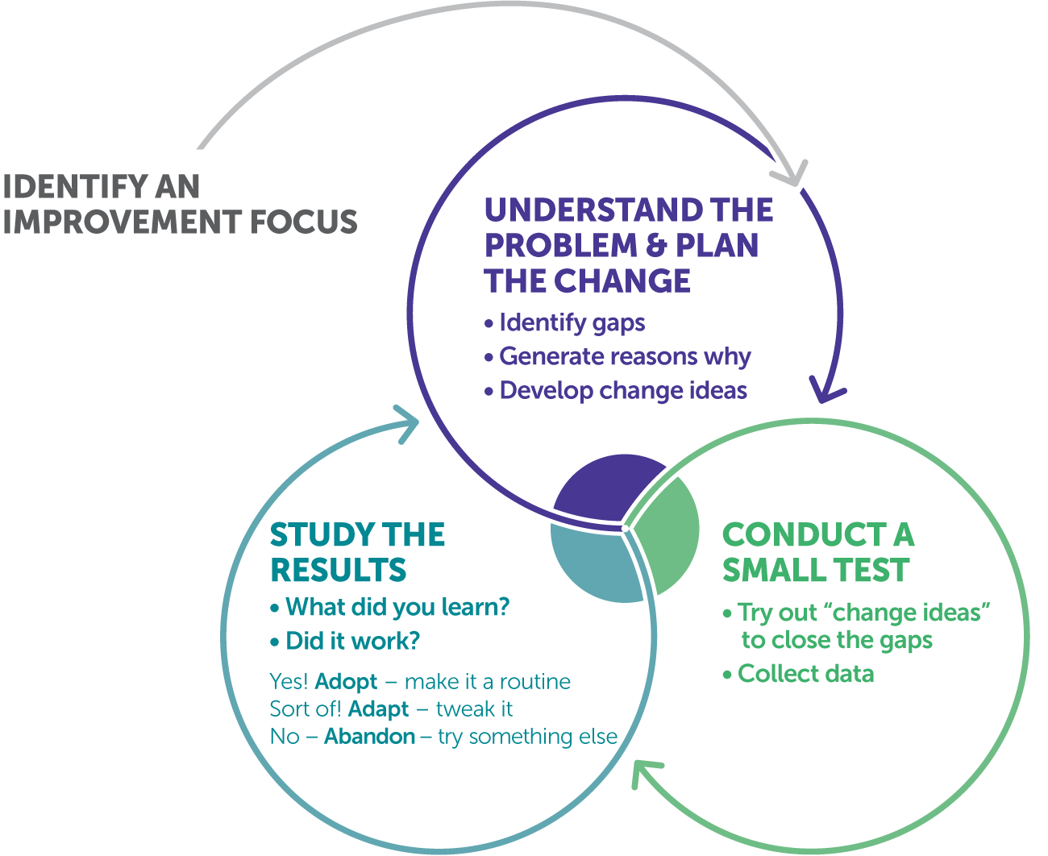
Teacher inquiry cycle
The teacher inquiry cycle is the vehicle to introduce improvement routines and a disciplined approach to learning.
Notes:
Tell participants that in an instructional setting, the teacher inquiry cycle is a vehicle that can be used to test and improve on changes, or to decide a change needs to be abandoned if it does not have the desired impact.

Slide 59
Key concepts of continuous improvement
Fail fast, learn fast.
Educators as empowered change agents.
Collaborative learning.
Learning how we get ideas to work.
Test ideas with increasing scale.
Source: Bowman, Dolle, & Takahashi (2019).
Notes:
Share that when engaging in inquiry cycles for improvement, some key concepts to consider are the following: you learn from failure, and the sooner you know something is not working the better; educators have the ability to change the system; learning is more effective when you have the opportunity to exchange ideas with others; short, iterative inquiry cycles allow you to adapt and adjust ideas and get them to work in new and different contexts; start small with testing, and gradually move to full implementation.

Slide 60
Self-reflection
What is your experience with doing improvement work?
How is this approach the same? How is it different?
Notes:
Provide a few minutes for individual reflection in the participant workbook and then ask if anyone would like to share their response with the group. Prepare some examples of differences, utilizing points from slide 59 in particular, in case participants don’t have any examples.

Slide 61
Theory of improvement

Slide 62
Theory of improvement
A theory of improvement helps to focus your continuous improvement work. It provides clarity and intentionality to what you are trying to accomplish.
Notes:
Share with participants that a theory of improvement is a written statement that is developed by the team during the improvement process. It can capture their improvement hypothesis and, in the discussion to develop the theory of improvement, can surface underlying assumptions.

Slide 63
Theory of improvement
A theory of improvement articulates the changes in your system that you believe need to be made to create the change in outcomes or performance that you are seeking.
Source: Bowman, Dolle, & Takahashi (2019).

Slide 64
Example sentence frame
If we ___________________________________,
then we will impact_______________________,
which will result in _______________________,
which will make progress toward our goal of _______________________________________.
Notes:
Participants should understand that a theory of improvement can take many different forms, ranging from a complex graphic organizer to an if-then statement. We are sharing the simplest form in a sentence frame.

Slide 65
Example theory of improvement
If we increase the amount of time our English learner (EL) students get to engage in both listening and speaking activities, using academic language with their peers,
then we will impact the academic language fluency of our EL students,
which will result in increased access to grade-level academic material and improved English language fluency and English Language Arts (ELA) proficiency for our EL students,
which will make progress toward our goal of improved reclassification rates.
Notes:
Prepare to share additional examples of theories of improvement that relate to your context. They do not need to be education-based.

Slide 66
Theory of improvement
Because it is a theory, and by definition a theory of improvement is unproven, it should still be as accurate as possible. The more certain you are regarding the causes of the problem, the more likely it will be that your theory is accurate.
As you learn more about the problem through the continuous improvement process, you should continue to update your theory.
Source: Bowman, Dolle, & Takahashi (2019).
Notes:
Share with participants that a theory of improvement is a hypothesis. Perfection is not the point. A theory of improvement is your best, well-educated guess, based on all the information you can access about a problem, but is not written in stone. You should build in time during the improvement process to review your theory of improvement. It may need to be changed or refined over time based on evidence and data collected as part of the improvement process.

Slide 67
Self-reflection
How might a theory of improvement help you focus your improvement work?
How might a theory of improvement be useful in your communication with staff and teachers?
Notes:
Provide a few minutes for individual reflection in participants’ workbooks and then ask if anyone would like to share their response with the group. Take two to three responses and move on.
If you have additional time, this prompt could also be used for a small-group discussion. Have examples ready to share in the event participants do not have responses.

Slide 68
Next steps

Slide 69
Module review
During this module, our learning targets were to …
Learn about systems and how you can impact system improvement.
Definition of a system.
Seeing the system.
Understand the role of equity in systems improvement work.
Surfacing inequities.
How systems improve.
Begin to develop a theory of improvement for your work.
Theory of improvement.
Notes:
As you review the module content, mention some of the key points.
Key points:
• Complex systems are systems within systems, each of which has the following components: leadership, context, culture, resources, and processes.
• Unless we slow down and surface and acknowledge our mental models and the assumptions, beliefs, and dispositions that shape them, it will be difficult to identify and solve the right problem.

Slide 70
Action period for Module 2
Use the processes shared to begin to investigate your system and start to identify areas of need.
Meet with school leadership to understand their priorities.
Work with the school leaders to identify focus areas for the school and/or team you will be working with.
Bonus reading: Now is the time for teachers to use data-based inquiry cycles
Notes:
Review the action period activities with the group, and be sure to answer any questions.
For this action period, make sure you share the link to the bonus reading: https://www.wested.org/wested-insights/rel-west-data-based-inquiry-cycles/

Slide 71
Closing reflection
Share:
What are you thinking about focusing on next to continue this work?
Notes:
Ask people to share aloud during in-person settings or in the chat for online participation.
This is also an opportunity to include a feedback survey.

Slide 72
References
Anaissie, T., Cary, V., Clifford, D., Malarkey, T., & Wise, S. (2021, June 7). Creative Commons Equity-centered design framework. Stanford d.school. Retrieved December 17, 2021, from https://dschool.stanford.edu/resources/equity-centered-design-framework
Barth, R. (2002). The culture builder. Educational Leadership, 59(8), 6–11. Retrieved December 28, 2021, from https://www.ascd.org/el/articles/the-culture-builder
Bay Area Coalition for Equitable Schools (BayCES). (2004). A guide to data-based inquiry: Using the cycle to drive learning and change for equity. BayCES, Oakland, CA.
Boston Consulting Group (2014). Teachers know best: Teachers’ views on professional development. Seattle, WA: Bill and Melinda Gates Foundation.
Both, T., & Baggereor, D. (2020, April 30). Design thinking bootcamp bootleg. Stanford, CA: Stanford d.school. https://dschool.stanford.edu/resources/the-bootcamp-bootleg
Bowman, A. (2011). Sphere of success [Activity]. National Equity Project, Oakland, CA.
Bowman, A. (2012). Things people say [Activity]. Alliance Learning Solutions.
Bowman, A., Dolle, J., & Takahashi, S. (2019). Improvement Science Institute [Presentation]. San Francisco, CA: WestEd.
Bryk, A., Gomez, L. M., Grunow, A., & LeMahieu, P. G. (2015). Learning to improve: How America’s schools can get better at getting better. Cambridge, MA: Harvard Education Press.
Bryk, A., Sebring, P. B., Allensworth, E., Luppescu, S., & Easton, J. Q. (2010). Organizing schools for improvement: Lessons from Chicago. Chicago, IL: University of Chicago Press.
Carnegie Foundation for the Advancement of Teaching, https://www.carnegiefoundation.org, retrieved April 22, 2021.
Center on School Turnaround. (2017). Four domains for rapid school improvement: A systems framework. San Francisco, CA: The Center for School Turnaround at WestEd.
Council of Chief State School Officers. (2013, April). InTASC Model Core Teaching Standards and Learning Progressions for Teachers 1.0: A resource for ongoing teacher development. Washington, DC: CCSSO.
Cristol, K., & Ramsey, B. S. (2014). Common Core in the districts: An early look at early implementers. Washington, DC: Thomas Fordham Institute.

Slide 73
References
Dana, N. F. (2014). The reflective educator's guide to classroom research: Learning to teach and teaching to learn through practitioner inquiry. Thousand Oaks, CA: Corwin Press.
Dechurch, L., Mesmer-Magnus, J., & Doty, D. (2013). Moving beyond relationship and task conflict: Toward a process-state perspective. Journal of Applied Psychology, 98(4), 559–578. https://doi.org/10.1037/a0032896
Desimone, L., Smith, T. M., & Ueno, K. (2006, April). Are teachers who need sustained, content-focused professional development getting it? An administrator’s dilemma. Educational Administration Quarterly, 42(2), 179–215.
Desimone, L. M. (2009, April 1). Improving impact studies of teachers’ professional development: Toward better conceptualizations and measures. Educational Researcher, 38(3), 181–199. https://journals.sagepub.com/stoken/rbtfl/hYeKyHG/tlbNA/full
Ermeling, B. A. (2009, February 2). Tracing the effects of teacher inquiry on classroom practice. Teaching and Teacher Education, 26(3), 377–388. https://doi.org/10.1016/j.tate.2009.02.019
Fong, P. (2020, December). Now is the time for teachers to use data-based inquiry cycles. Insights & Impact. REL West at WestEd. Retrieved December 28, 2021, from https://www.wested.org/wested-insights/rel-west-data-based-inquiry-cycles/#.
Graham, S., Bollinger, A., Booth Olson, C., D’Aoust, C., MacArthur, C., McCutchen, D., & Olinghouse, N. (2012). Teaching elementary school students to be effective writers: A practice guide (NCEE 2012- 4058). Washington, DC: National Center for Education Evaluation and Regional Assistance, Institute of Education Sciences, U.S. Department of Education. Retrieved from http://ies.ed.gov/ncee/ wwc/publications_reviews.aspx#pubsearch.
Grossman, P., Loeb, S., Cohen, J., Hammerness, K., Wyckoff, J., Boyd, D., et al. (2010). Measure for measure: The relationship between measures of instructional practice in middle school English language arts and teachers’ value-added scores. Cambridge, MA: National Bureau of Economic Research.
Gunrow, A, & Park, S. (2017). Creative Commons Improvement Science Coaching [Presentation]. Licensed by C.C. BY-NC-SA.
Gürdür, D., & Törngren, M. (2018). Visual analytics for cyber-physical systems development: Blending design thinking and systems thinking. Stockholm, Sweden: NordDesign, Department of Machine Design, KTH Royal Institute of Technology.
Hamilton, L., Halverson, R., Jackson, S., Mandinach, E., Supovitz, J., & Wayman, J. (2009). Using student achievement data to support instructional decision making (NCEE 2009-4067). Washington, DC: National Center for Education Evaluation and Regional Assistance, Institute of Education Sciences, U.S. Department of Education. Retrieved from https://ies.ed.gov/ncee/wwc/PracticeGuide/12
Heckman, J. (2017, February 6). The Achievement Gap starts at birth. The Heckman Equation. Retrieved September 15, 2021, from https://heckmanequation.org/resource/starts-at-birth/

Slide 74
References
Hough, H. J., Kerbow, D., Bryk, A., Pinnell, G. S., Rodgers, E., Dexter, E., et al. (2012). Assessing teacher practice and development: The case of comprehensive literacy instruction. School Effectiveness and School Improvement: An International Journal of Research, Policy and Practice 24(4). https://doi.org/10.1080/09243453.2012.731004
Hough, H., Willis, J., Gunrow, A., Krausen, K.., Kwon, S., et al. (2017, November). Continuous improvement in practice. Policy Analysis for California Education. https://www.edpolicyinca.org/publications/continuous-improvement-practice
Kana, J., Kramer, M., & Senge, P. (2021, July 8). The water of systems change. FSG. Retrieved December 17, 2021, from https://www.fsg.org/publications/water_of_systems_change
Kegan, R., & Lahey, L. L. (2001). How the way we talk can change the way we work: Seven languages for transformation. San Francisco, CA: Jossey-Bass.
Langley, G. J., Moen, R., Nolan, K. M., Nolan, T. W., Norman, C. L., & Provost, L. P. (2009). The Improvement Guide. John Wiley & Sons.
Lipton, L., & Wellman, B. M. (2012). Got data? Now what?: Creating and leading cultures of inquiry. Bloomington, IN: Solution Tree Press.
National Equity Project, https://www.nationalequityproject.org/, retrieved December 20, 2020.
Read, J. D. (1983). Detection of Fs in a single statement: The role of phonetic recoding. Memory & Cognition, 11(4), 390–399. https://doi.org/10.3758/bf03202454
Tuckman, Bruce W. (1965). Developmental sequence in small groups. Psychological Bulletin, 63, 384–399.
Valdez, A., Takahashi, S., Krausen, K., Bowman, A., & Gurrola, E. (2020). Getting better at getting more equitable: Opportunities and barriers for using continuous improvement to advance educational equity. San Francisco, CA: WestEd.
Weisberg, A. (2019, January 29). How to conduct needs assessment part 1: What is it and why do it? NC State Industry Expansion Solutions. Retrieved December 17, 2021, from https://www.ies.ncsu.edu/blog/how-to-conduct-needs-assessment-part-1-what-is-it-and-why-do-it/

